Slide 1

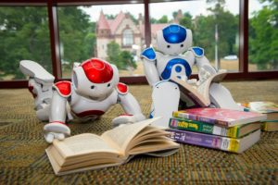
Machine Learning 530
Generative Adversarial Networks, GANs
Steve Elston
Copyright 2019, 2022 Stephen F Elston. All rights reserved.

Slide 2
Generative Adversarial Networks
GANs are a rapidly advancing class of generative models
GAN algorithm proposed by Goodfellow, et.al. 2014
GANs algorithms are used in some applications as GAN algorithms have advanced including:
Create ‘skins’ for skeletons of design tools
Text to image generation
Super resolution
Data augmentation
Scene in-painting
GAN algorithms are advancing rapidly and a focus of intense research
This lesson is a point in time overview of GAN theory and algorithms
Focus on core principles rather than the zoo of many specialized algorithms

Slide 3
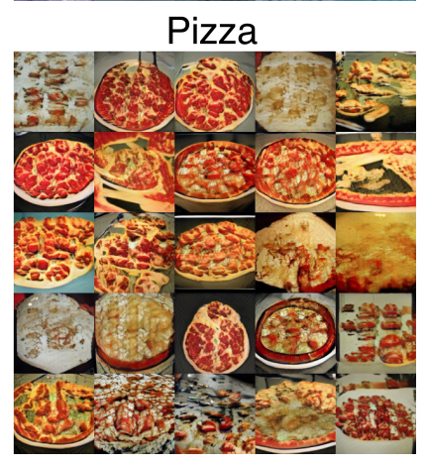
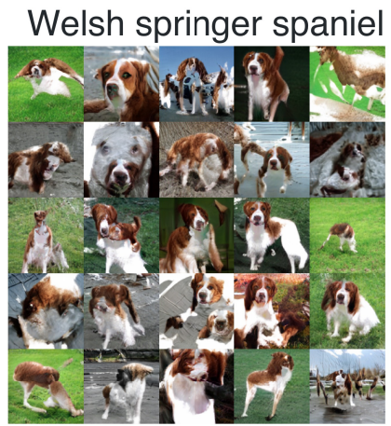
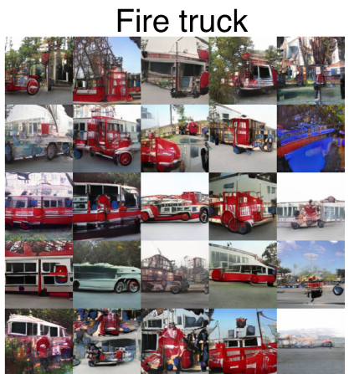
Introduction to GANs
Images generated by state-of-the-art SN-GAN model, Miyato, et. al., 2018
128x128 color images

Slide 4
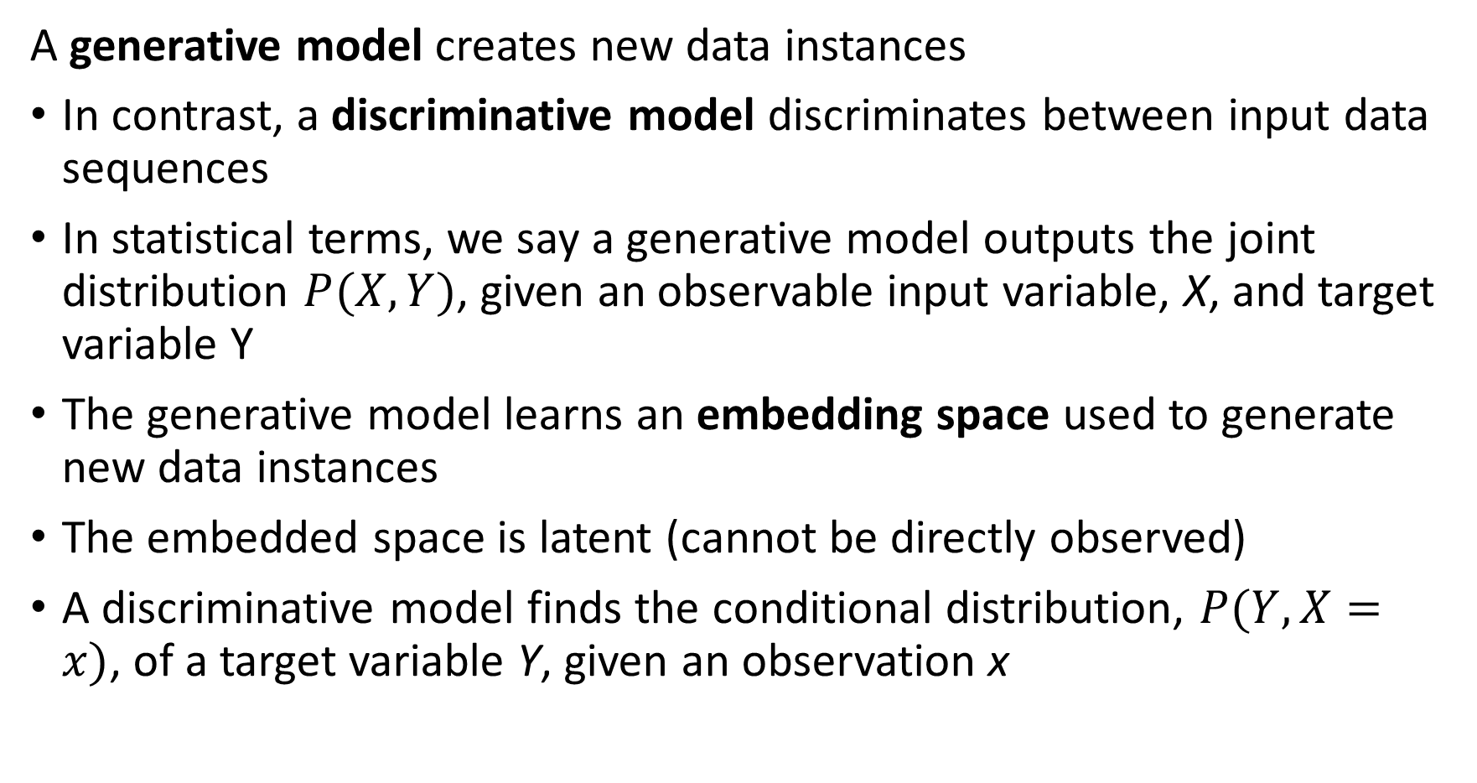
Generative Models
A generative model creates new data instances
In contrast, a discriminative model discriminates between input data sequences
In statistical terms, we say a generative model outputs the joint distribution $P(X,Y)$, given an observable input variable, X, and target variable Y
The generative model learns an embedding space used to generate new data instances
The embedded space is latent (cannot be directly observed)
A discriminative model finds the conditional distribution, $P(Y,X=x)$, of a target variable Y, given an observation x

Slide 5
Generative Models
Generative Models output new data cases
A generator learns an embedding space from data input
Generator produces output data from embedding space from random seed, z
A critic or discriminative model evaluates the quality of the output with feedback used to improve learning of embedding space
Training Data
Z
Critic
Embedding Space
Generator
Output

Slide 6
Introduction to GANs
Generative adversarial networks (GANs) comprise two models which work in opposition to each other
A generator that creates new data instances starting from random noise
A discriminator that attempts to differentiate between actual data instances and generated data
The generator and discriminator engage in a two player non-cooperative zero sum game
The generator attempts to fool the discriminator and the discriminator attempts to identify the output of the generator

Slide 7
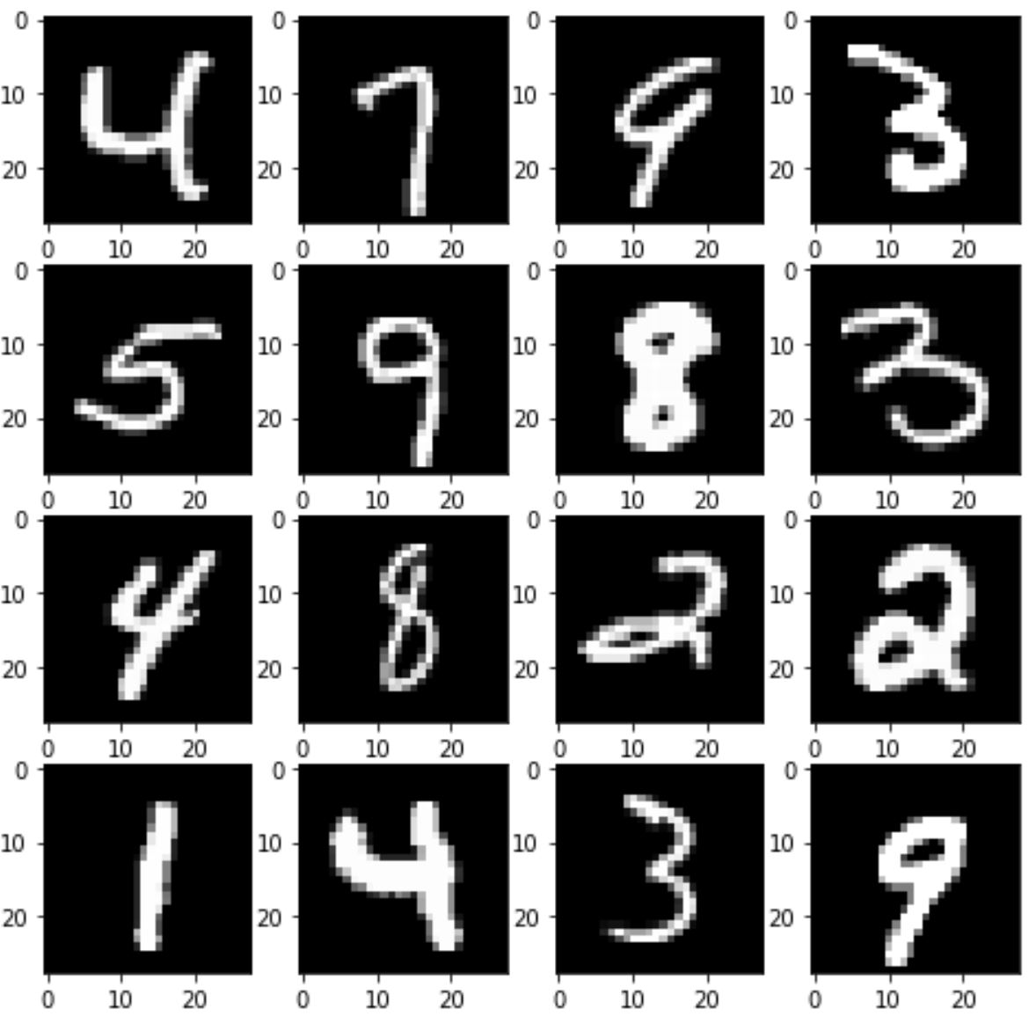
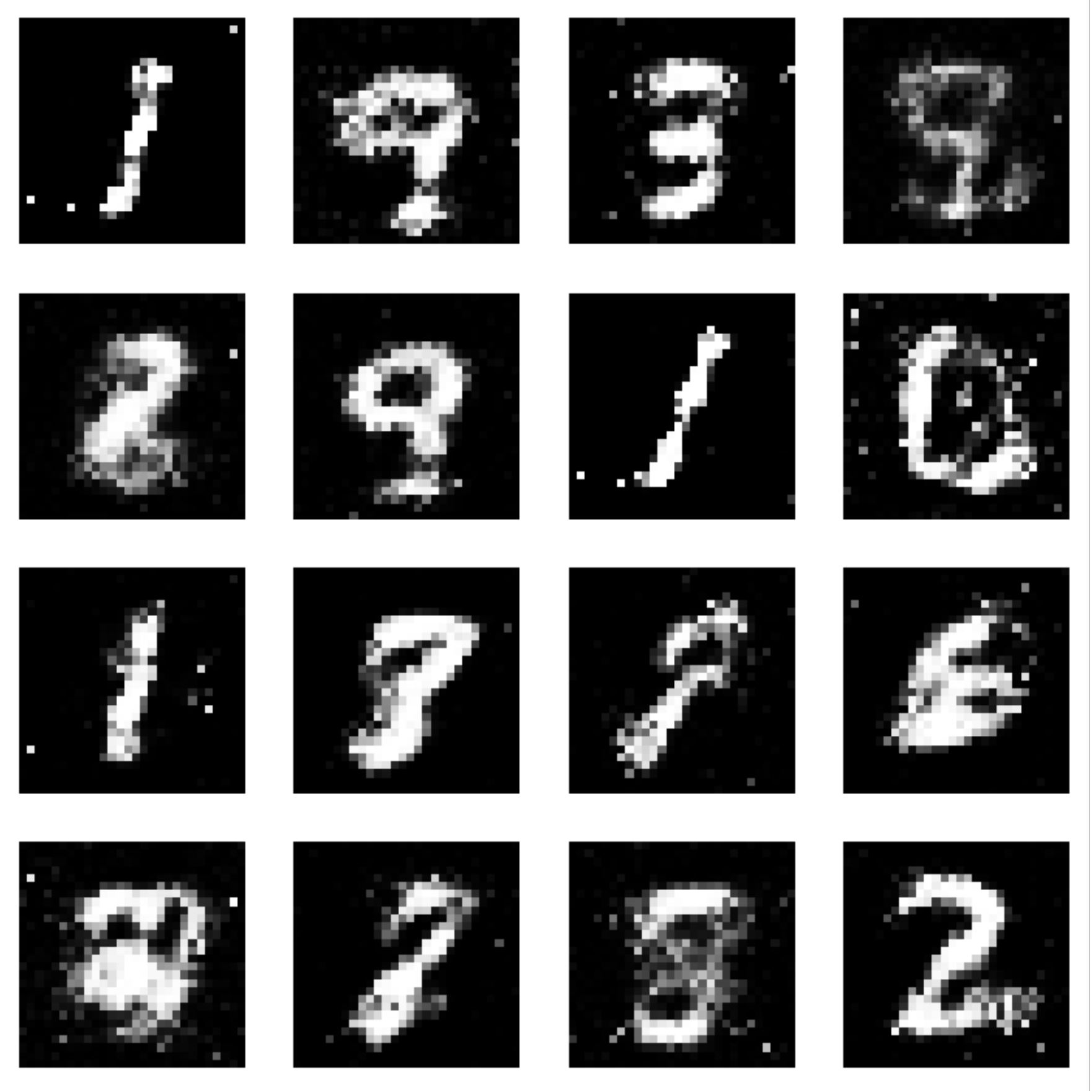
Basic GAN architecture
Discriminator
Loss
Training Data
Real Images
Generator
Noise
Generated Images

Slide 8
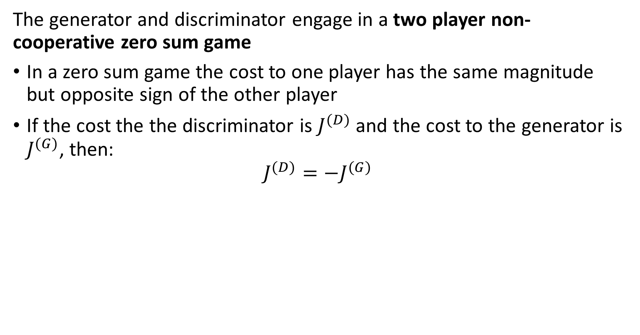
A bit of game theory
The generator and discriminator engage in a two player non-cooperative zero sum game
In a zero sum game the cost to one player has the same magnitude but opposite sign of the other player
If the cost the the discriminator is $J^{(D)}$ and the cost to the generator is $J^{(G)}$, then:
$$J^{(D)}=−J^{(G)}$$

Slide 9
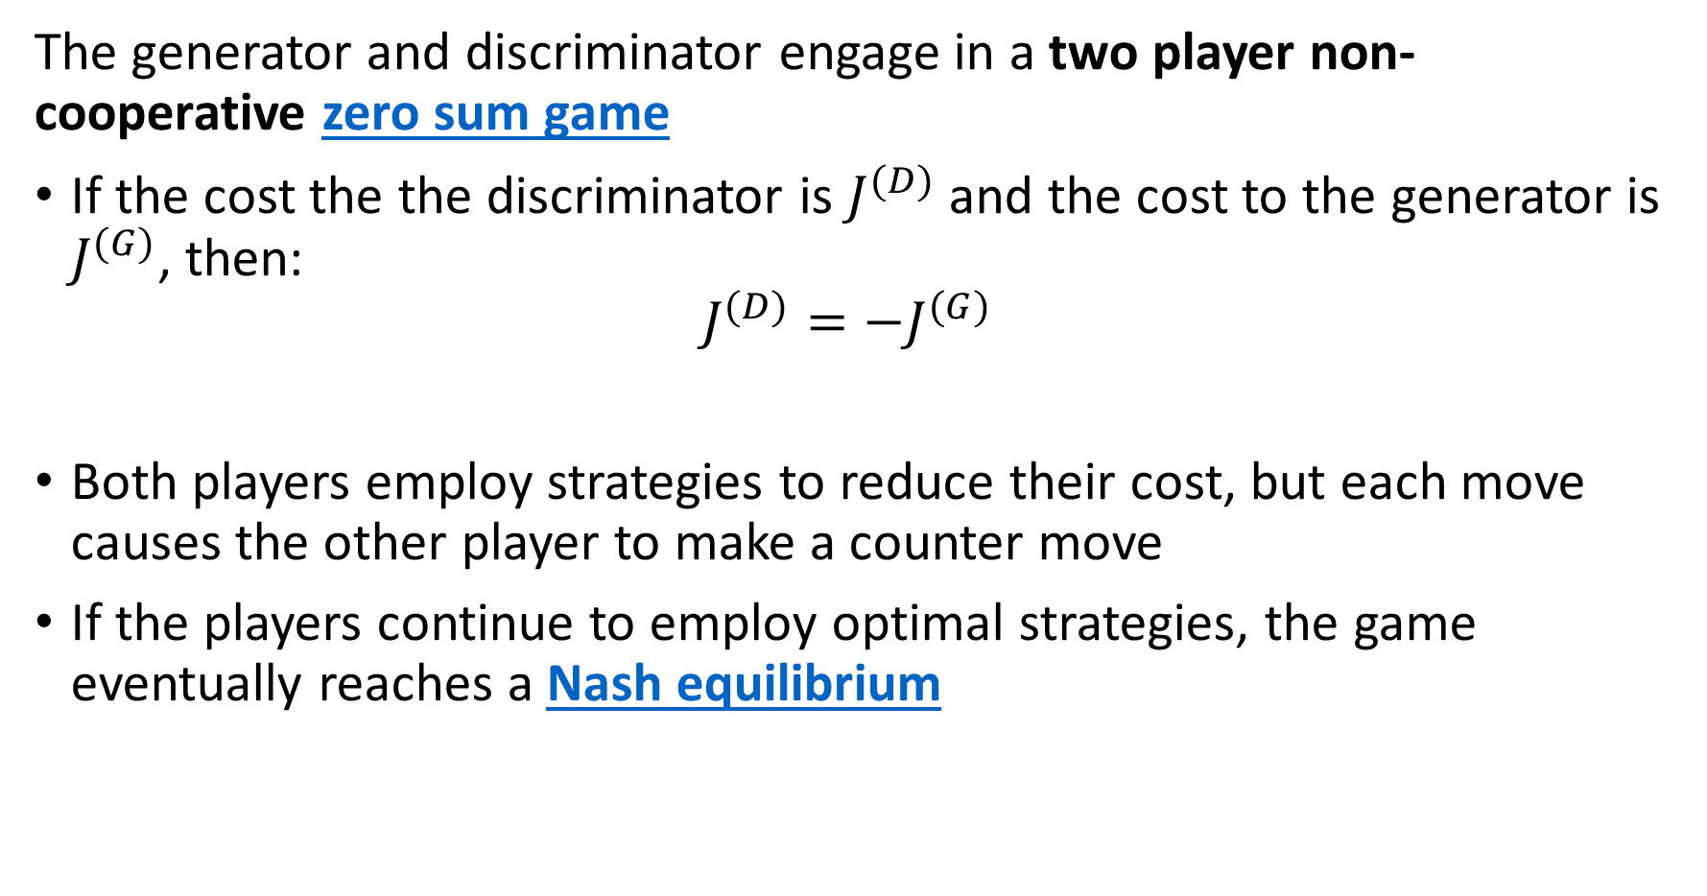
A bit of game theory
The generator and discriminator engage in a two player non-cooperative zero sum game
If the cost the the discriminator is $J^{(D)}$ and the cost to the generator is $J^{(G)}$, then:
$$J^{(D)}=−J^{(G)}$$
Both players employ strategies to reduce their cost, but each move causes the other player to make a counter move
If the players continue to employ optimal strategies, the game eventually reaches a Nash equilibrium

Slide 10
A bit of game theory
The generator and discriminator engage in a two player non-cooperative zero sum game
If the players continue to employ optimal strategies, the game eventually reaches a Nash equilibrium
Intuitively, at Nash equilibrium, the players are deadlocked
A first player makes an optimal move to reduce costs
The other player to make an optimal counter move to reduce cost
Counter move increases cost of the first player
A subsequent optimal counter-counter move of first player increases cost of the second player
etc…

Slide 11
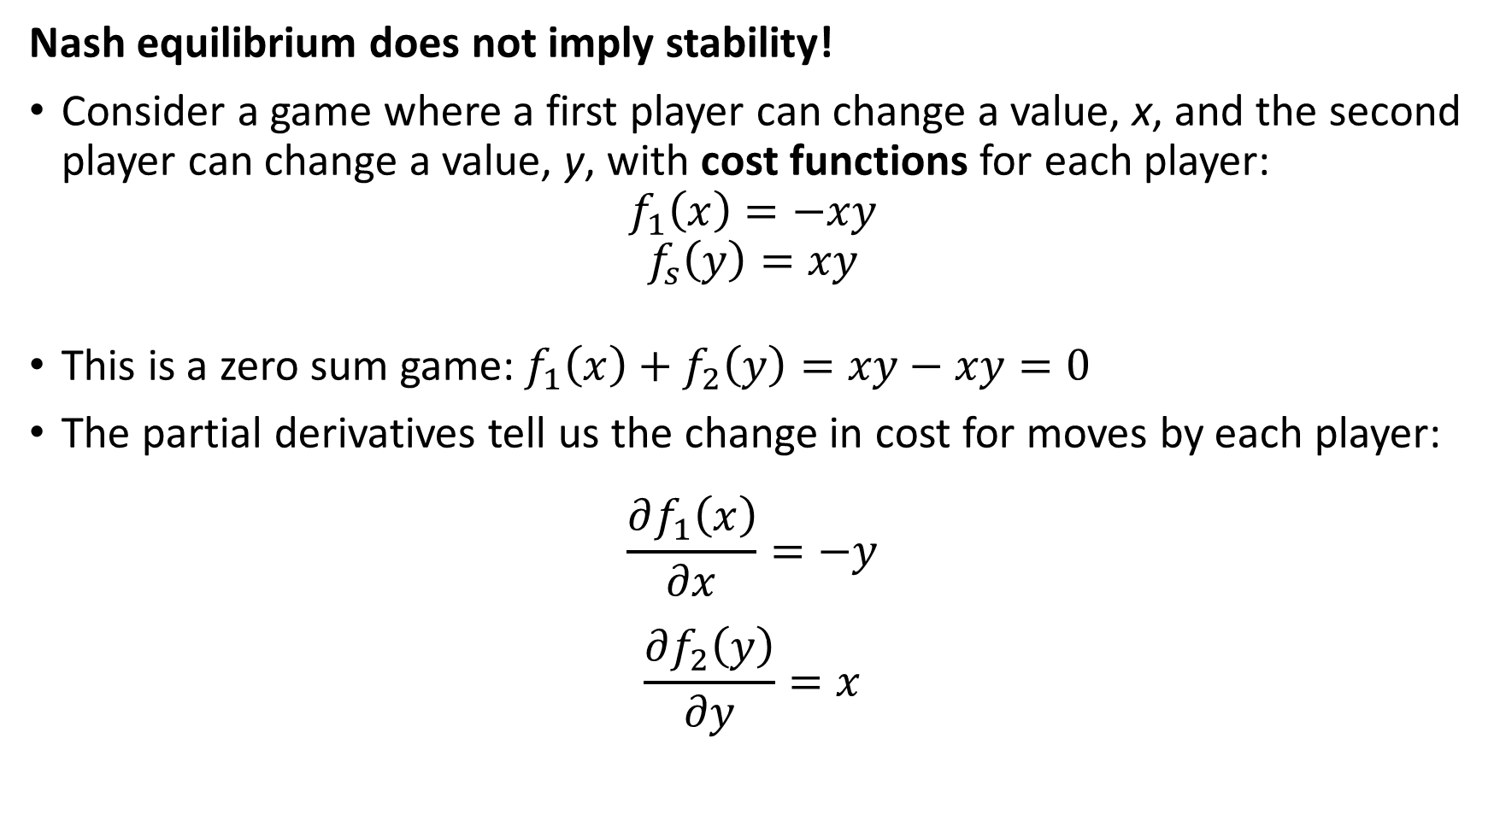
A bit of game theory
Nash equilibrium does not imply stability!
Consider a game where a first player can change a value, x, and the second player can change a value, y, with cost functions for each player:
$$f_{1}\left(x\right)=−xy$$
$$f_{s}\left(y\right)=xy$$
This is a zero sum game:$f_{1}\left(x\right)+f_{2}\left(y\right)=xy−xy=0$
The partial derivatives tell us the change in cost for moves by each player:
$$\frac{∂f_{1}\left(x\right)}{∂x}=−y$$
$$\frac{∂f_{2}\left(y\right)}{∂y}=x$$

Slide 12
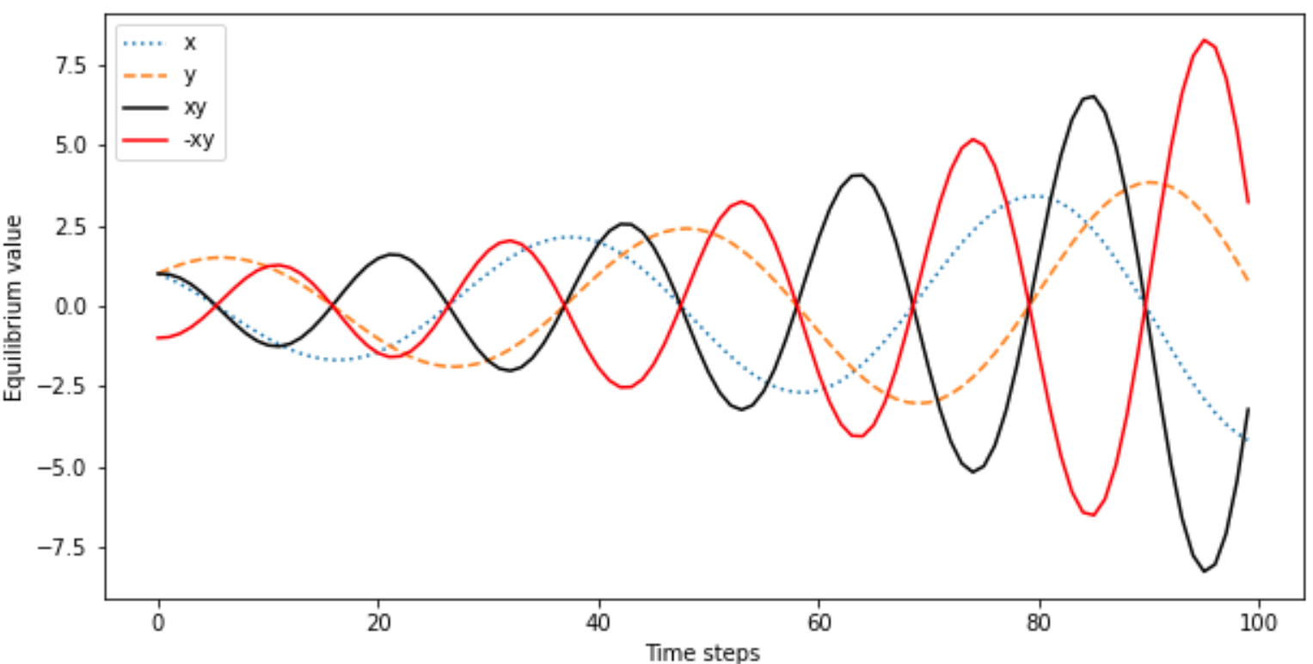
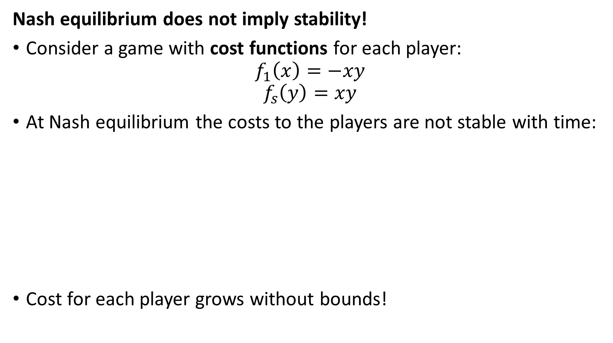
A bit of game theory
Nash equilibrium does not imply stability!
Consider a game with cost functions for each player:
$$f_{1}\left(x\right)=−xy$$
$$f_{s}\left(y\right)=xy$$
At Nash equilibrium the costs to the players are not stable with time:
Cost for each player grows without bounds!

Slide 13
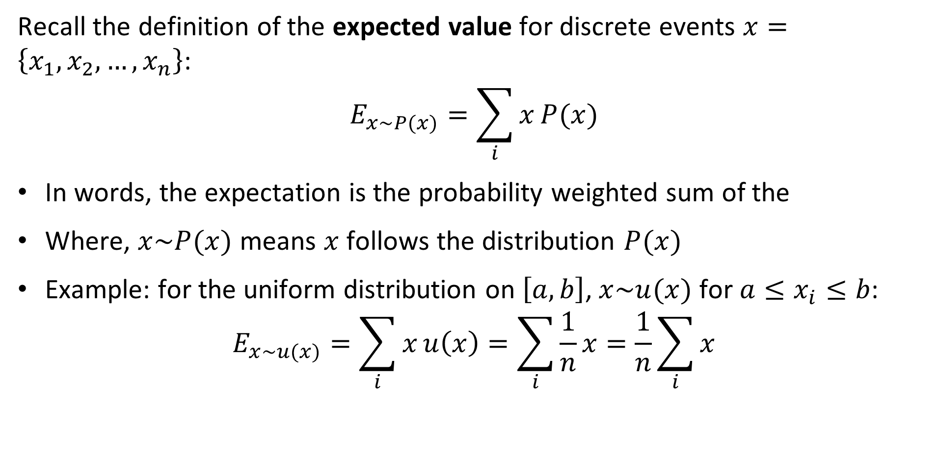
Review: Expected Value
Recall the definition of the expected value for discrete events $x=\left\{x_{1},x_{2},…,x_{n}\right\}$:
$$E_{x\sim P(x)}=\sum_{i}{x}P(x)$$
In words, the expectation is the probability weighted sum of the
Where, $x\sim P(x)$ means $x$ follows the distribution $P(x)$
Example: for the uniform distribution on $\left[a,b\right]$, $x\sim u(x)$ for $a≤x_{i}≤b$:
$$E_{x\sim u(x)}=\sum_{i}{x}u\left(x\right)=\sum_{i}{\frac{1}{n}x}=\frac{1}{n}\sum_{i}{x}$$

Slide 14
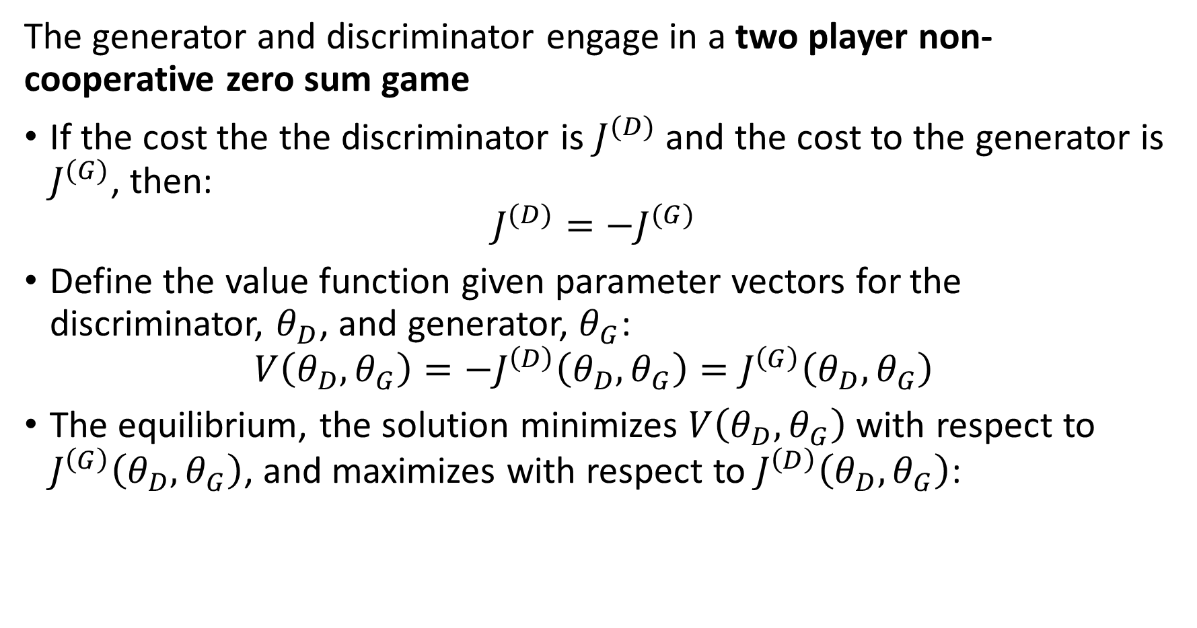
Game theory and GAN training
The generator and discriminator engage in a two player non-cooperative zero sum game
If the cost the the discriminator is $J^{(D)}$ and the cost to the generator is $J^{(G)}$, then:
$$J^{(D)}=−J^{(G)}$$
Define the value function given parameter vectors for the discriminator, $θ_{D}$, and generator, $θ_{G}$:
$$V\left(θ_{D},θ_{G}\right)=−J^{\left(D\right)}\left(θ_{D},θ_{G}\right)=J^{\left(G\right)}\left(θ_{D},θ_{G}\right)$$
The equilibrium, the solution minimizes $V\left(θ_{D},θ_{G}\right)$ with respect to $J^{\left(G\right)}\left(θ_{D},θ_{G}\right)$, and maximizes with respect to $J^{\left(D\right)}\left(θ_{D},θ_{G}\right)$:

Slide 15
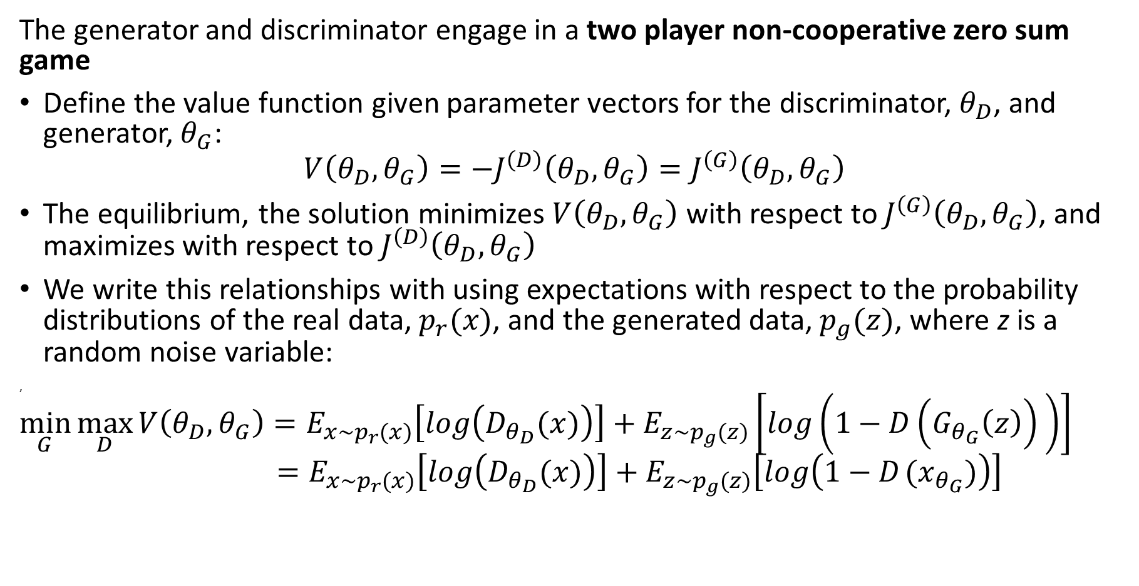
Game theory and GAN training
The generator and discriminator engage in a two player non-cooperative zero sum game
Define the value function given parameter vectors for the discriminator, $θ_{D}$, and generator, $θ_{G}$:
$$V\left(θ_{D},θ_{G}\right)=−J^{\left(D\right)}\left(θ_{D},θ_{G}\right)=J^{\left(G\right)}\left(θ_{D},θ_{G}\right)$$
The equilibrium, the solution minimizes $V\left(θ_{D},θ_{G}\right)$ with respect to $J^{\left(G\right)}\left(θ_{D},θ_{G}\right)$, and maximizes with respect to $J^{\left(D\right)}\left(θ_{D},θ_{G}\right)$
We write this relationships with using expectations with respect to the probability distributions of the real data, $p_{r}(x)$, and the generated data, $p_{g}(z)$, where z is a random noise variable:
,
$$\min_{G}{\max_{D}{V\left(θ_{D},θ_{G}\right)=E_{x\sim p_{r}(x)}\left[log\left(D_{θ_{D}}(x)\right)\right]+E_{z\sim p_{g}(z)}\left[log\left({1−D\left(G_{θ_{G}}\left(z\right)\right)}_{ }\right)\right] \underset{ }{}{{ =E_{x\sim p_{r}(x)}\left[log\left(D_{θ_{D}}(x)\right)\right]+E_{z\sim p_{g}(z)}\left[log\left({1−D}_{ }(x_{θ_{G}})\right)\right]}}}}$$

Slide 16
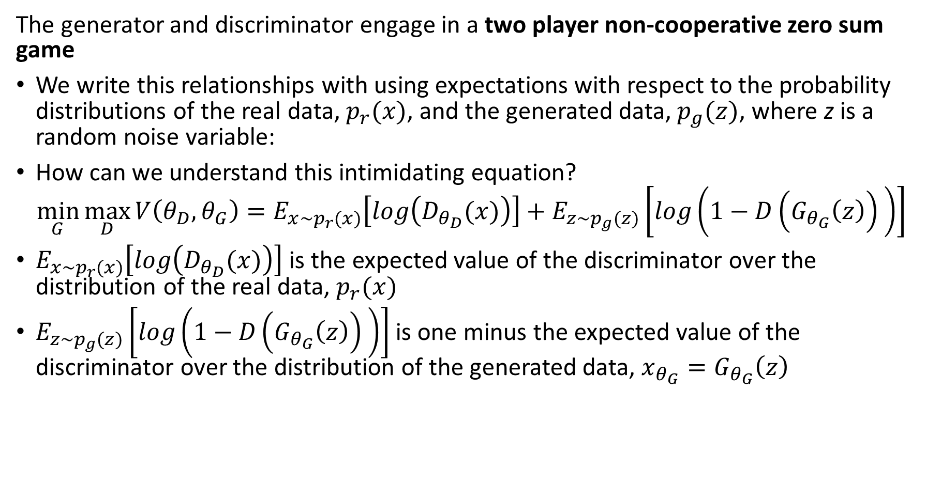
Game theory and GAN training
The generator and discriminator engage in a two player non-cooperative zero sum game
We write this relationships with using expectations with respect to the probability distributions of the real data, $p_{r}(x)$, and the generated data, $p_{g}(z)$, where z is a random noise variable:
How can we understand this intimidating equation?
$$\min_{G}{\max_{D}{V\left(θ_{D},θ_{G}\right)=E_{x\sim p_{r}(x)}\left[log\left(D_{θ_{D}}(x)\right)\right]+E_{z\sim p_{g}(z)}\left[log\left({1−D\left(G_{θ_{G}}\left(z\right)\right)}_{ }\right)\right] }}$$
$E_{x\sim p_{r}(x)}\left[log\left(D_{θ_{D}}(x)\right)\right]$ is the expected value of the discriminator over the distribution of the real data, $p_{r}(x)$
$E_{z\sim p_{g}(z)}\left[log\left({1−D\left(G_{θ_{G}}\left(z\right)\right)}_{ }\right)\right]$ is one minus the expected value of the discriminator over the distribution of the generated data, $x_{θ_{G}}=G_{θ_{G}}\left(z\right)$

Slide 17
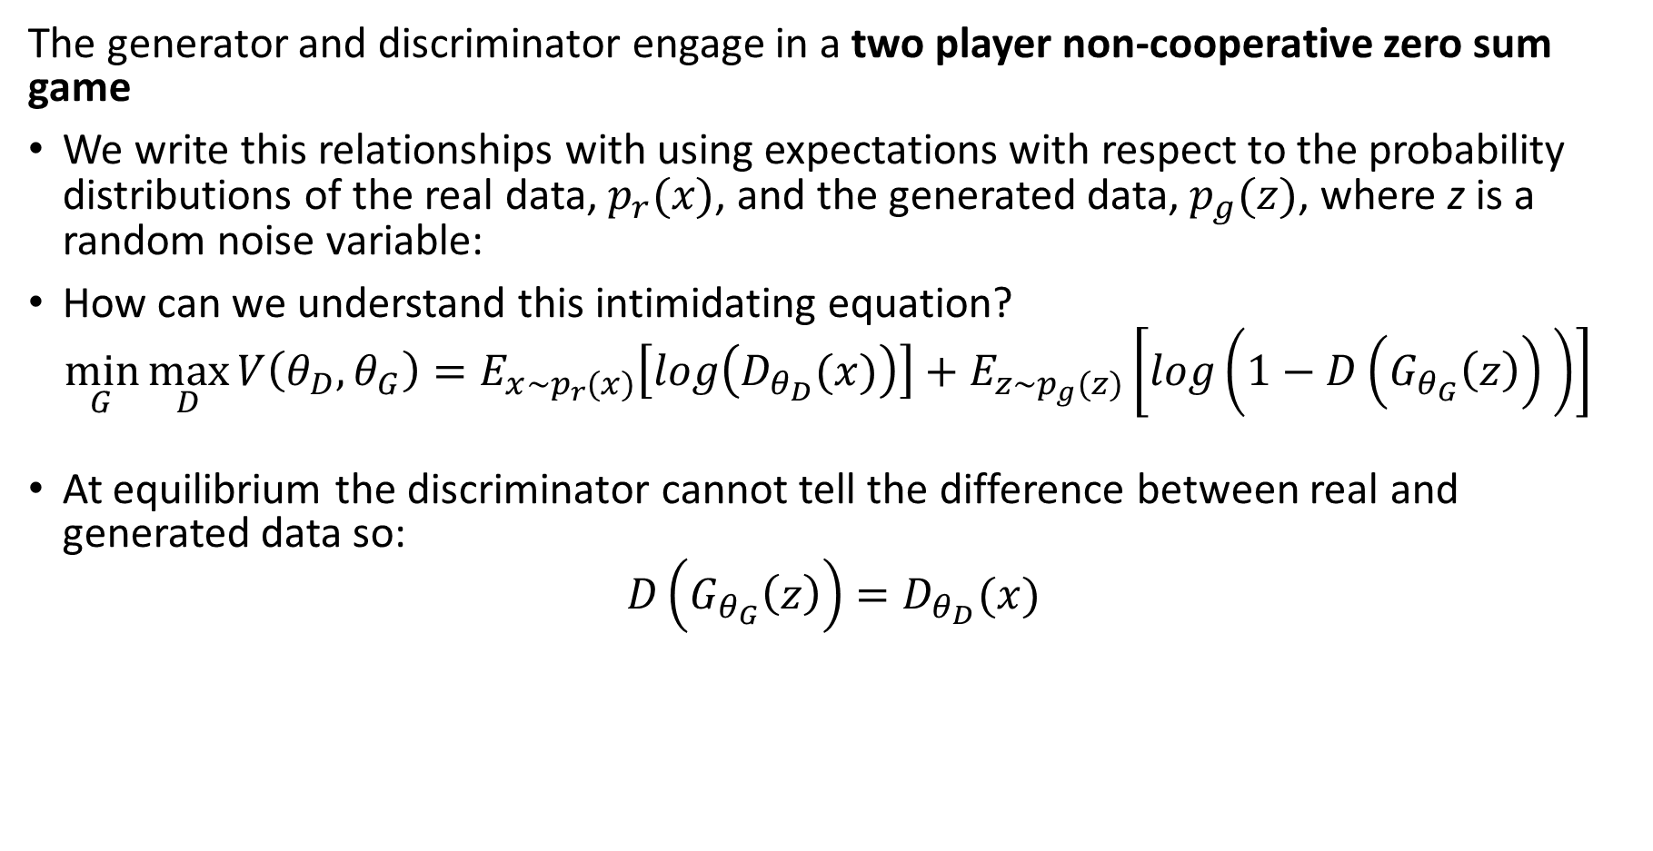
Game theory and GAN training
The generator and discriminator engage in a two player non-cooperative zero sum game
We write this relationships with using expectations with respect to the probability distributions of the real data, $p_{r}(x)$, and the generated data, $p_{g}(z)$, where z is a random noise variable:
How can we understand this intimidating equation?
$$\min_{G}{\max_{D}{V\left(θ_{D},θ_{G}\right)=E_{x\sim p_{r}(x)}\left[log\left(D_{θ_{D}}(x)\right)\right]+E_{z\sim p_{g}(z)}\left[log\left({1−D\left(G_{θ_{G}}\left(z\right)\right)}_{ }\right)\right] }}$$
At equilibrium the discriminator cannot tell the difference between real and generated data so:
$$D\left(G_{θ_{G}}\left(z\right)\right)=D_{θ_{D}}(x)$$

Slide 18
Game theory and GAN training
How do we train a discriminator and generator?
Need to train both models together
Discriminator is a binary classifier
Use standard training algorithm
Generator uses discriminator to compute loss function
Complete algorithm alternate between training discriminator and generator

Slide 19
Basic GAN architecture
Discriminator
Loss
Training Data
Real Images
Generator
Noise
Generated Images

Slide 20
Game theory and GAN training
Train discriminator as per any classifier
Train generator in opposition to discriminator
Input real data, x
Input noise, z
Differentiable function D(x)
Differentiable function G(z)
D(x) tries to be close to 1
And
D(G(z)) close to 0
x* sampled from G(z)
D(x) = D(G(z))
D learns to get D(G(z)) close to 0 and
G tries to make D(G(z)) close to 1

Slide 21
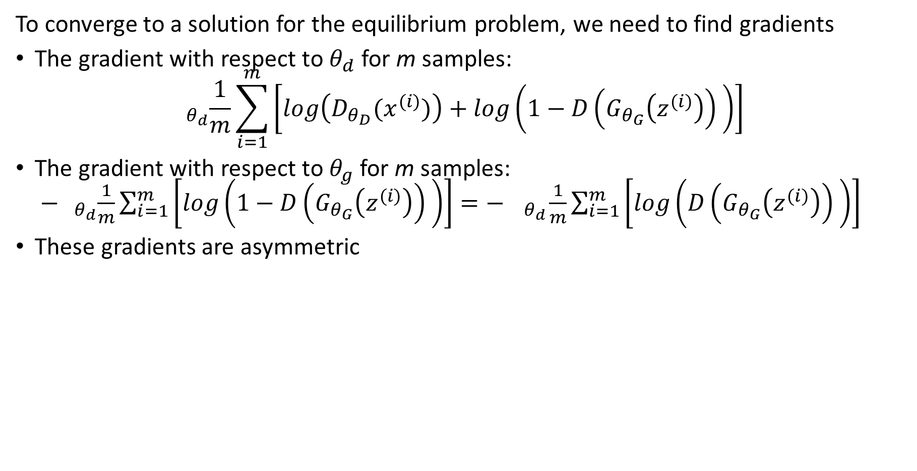
Gradients of the value function
To converge to a solution for the equilibrium problem, we need to find gradients
The gradient with respect to $θ_{d}$ for m samples:
$$_{θ_{d}}\frac{1}{m}\sum_{i=1}^{m}{\left[log\left(D_{θ_{D}}(x^{(i)})\right)+log\left({1−D\left(G_{θ_{G}}\left(z^{(i)}\right)\right)}_{ }\right)\right]}$$
The gradient with respect to $θ_{g}$ for m samples: $−{{ }_{θ_{d}}\frac{1}{m}\sum_{i=1}^{m}{\left[log\left({1−D\left(G_{θ_{G}}\left(z^{(i)}\right)\right)}_{ }\right)\right]=− { }_{θ_{d}}\frac{1}{m}\sum_{i=1}^{m}{\left[log\left({D\left(G_{θ_{G}}\left(z^{(i)}\right)\right)}_{ }\right)\right]}}}$
These gradients are asymmetric

Slide 22
Gradients of the value function
To converge to a solution for the equilibrium problem, we need to find gradients
Gradients have asymmetric behavior
Large region of near 0 gradient – this is a problem for learning!
E_{z}[Log(D(G(z)))]
Increasing J^{(G)}
E_{z}[Log(1 – D(G(z)))]
0
Increasing D(G(z))

Slide 23
Mode collapse and training failure
Mode collapse is a common problem that prevents GANs from learning
Mode collapse is a dead lock in the two-player game
Example: discriminator becomes too good at recognizing fake image and stops generator from learning
Example: discriminator and generator alternate between modes of the loss function
Example: gradient of loss function becomes nearly zero – typically for generator

Slide 24
Mode collapse and training failure
Discriminator learns one mode is true data
Discriminator learns p = .5 true data
Generator learns
one mode
Generator learns
other mode
Discriminator learns p = .5 true data
Discriminator learns one mode is true data
0
Actual data
1
Train generator
2
Train discriminator
3
Train generator
4
Train discriminator

Slide 25
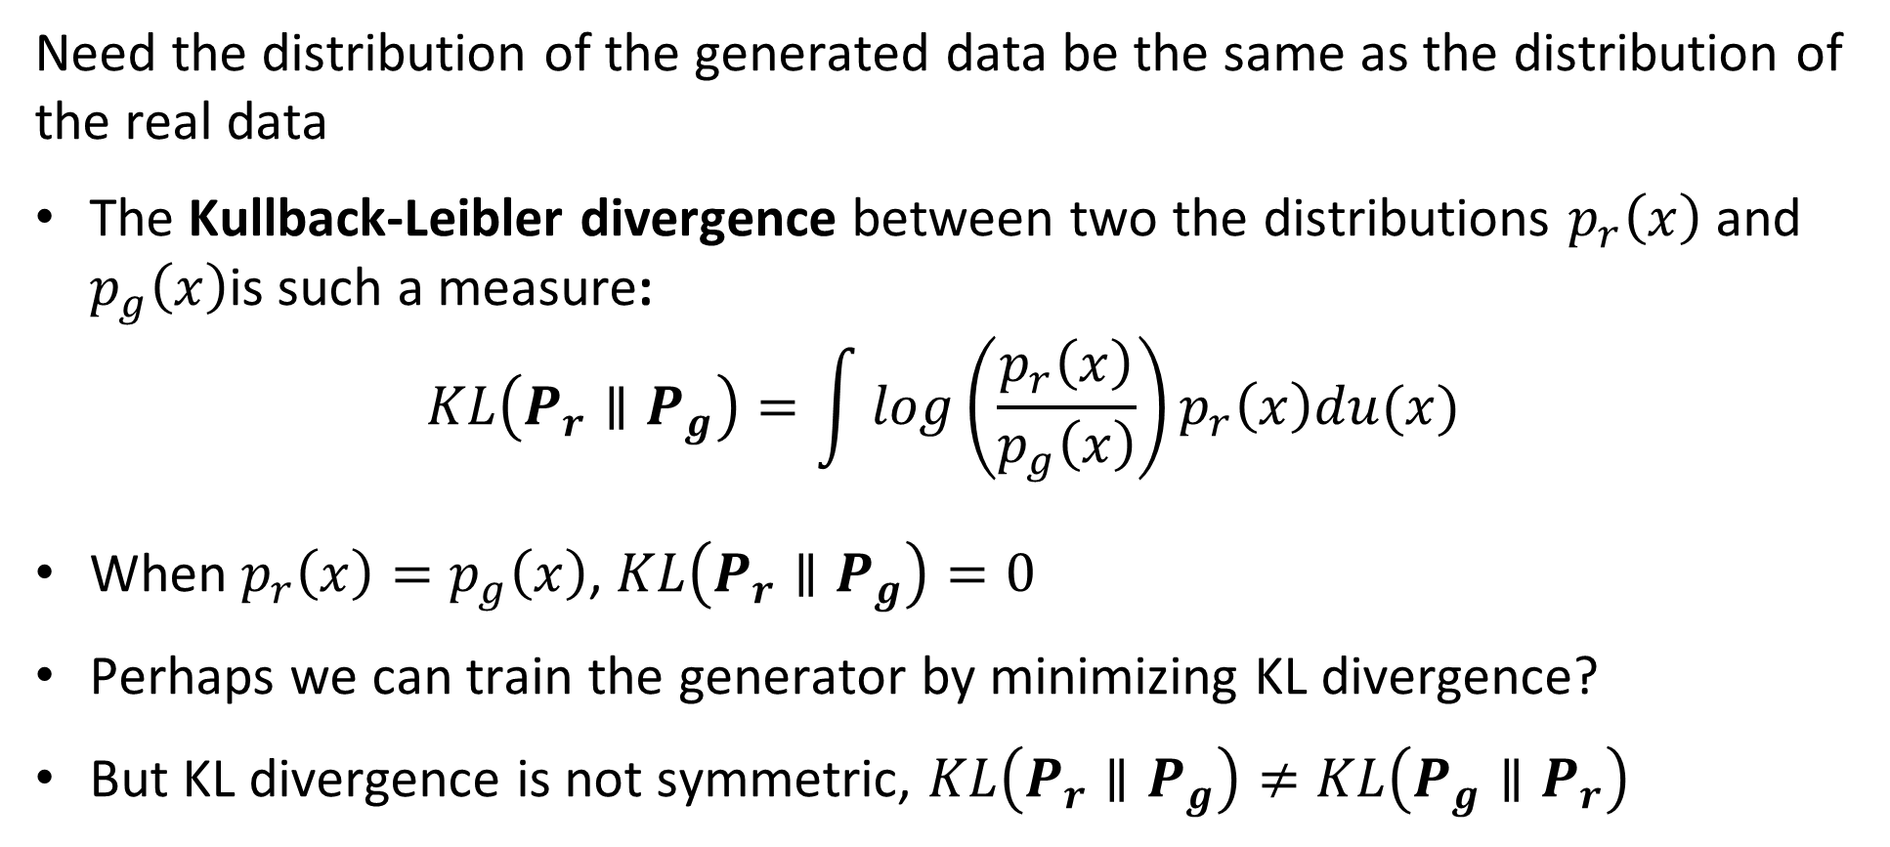
Loss Functions for Training Neural Networks
Need the distribution of the generated data be the same as the distribution of the real data
The Kullback-Leibler divergence between two the distributions $p_{r}\left(x\right)$ and $p_{g}\left(x\right)$is such a measure:
$$KL\left(P_{r}∥P_{g}\right)=\int{log\left(\frac{p_{r}\left(x\right)}{p_{g}\left(x\right)}\right)}p_{r}\left(x\right)du(x)$$
When $p_{r}\left(x\right)=p_{g}\left(x\right)$, $KL\left(P_{r}∥P_{g}\right)=0$
Perhaps we can train the generator by minimizing KL divergence?
But KL divergence is not symmetric, $KL\left(P_{r}∥P_{g}\right)≠KL\left(P_{g}∥P_{r}\right)$

Slide 26
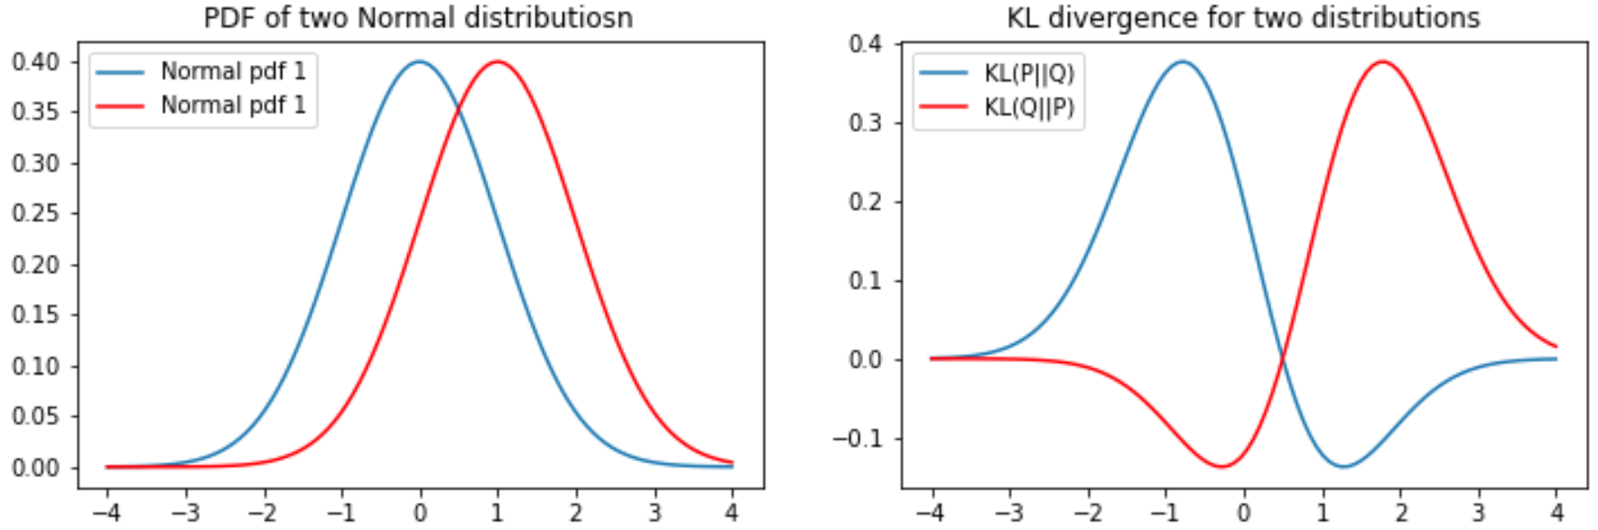
Loss Functions for Training Neural Networks
The KL divergence is asymmetric
For two distributions the KL divergence depend on the order or arguments
Notice that the gradient becomes near zero on one side of the KL function

Slide 27
The Wasserstein distance metric
The Wasserstein distance metric is symmetric and intuitive
The Wasserstein distance metric symmetric and with bounded gradients
Wasserstein GAN, or W-GAN (Arjovsky, et. al. 2017) uses the Wasserstein distance as a loss function
Using the Wasserstein loss helps W-GANs avoid mode collapse

Slide 28
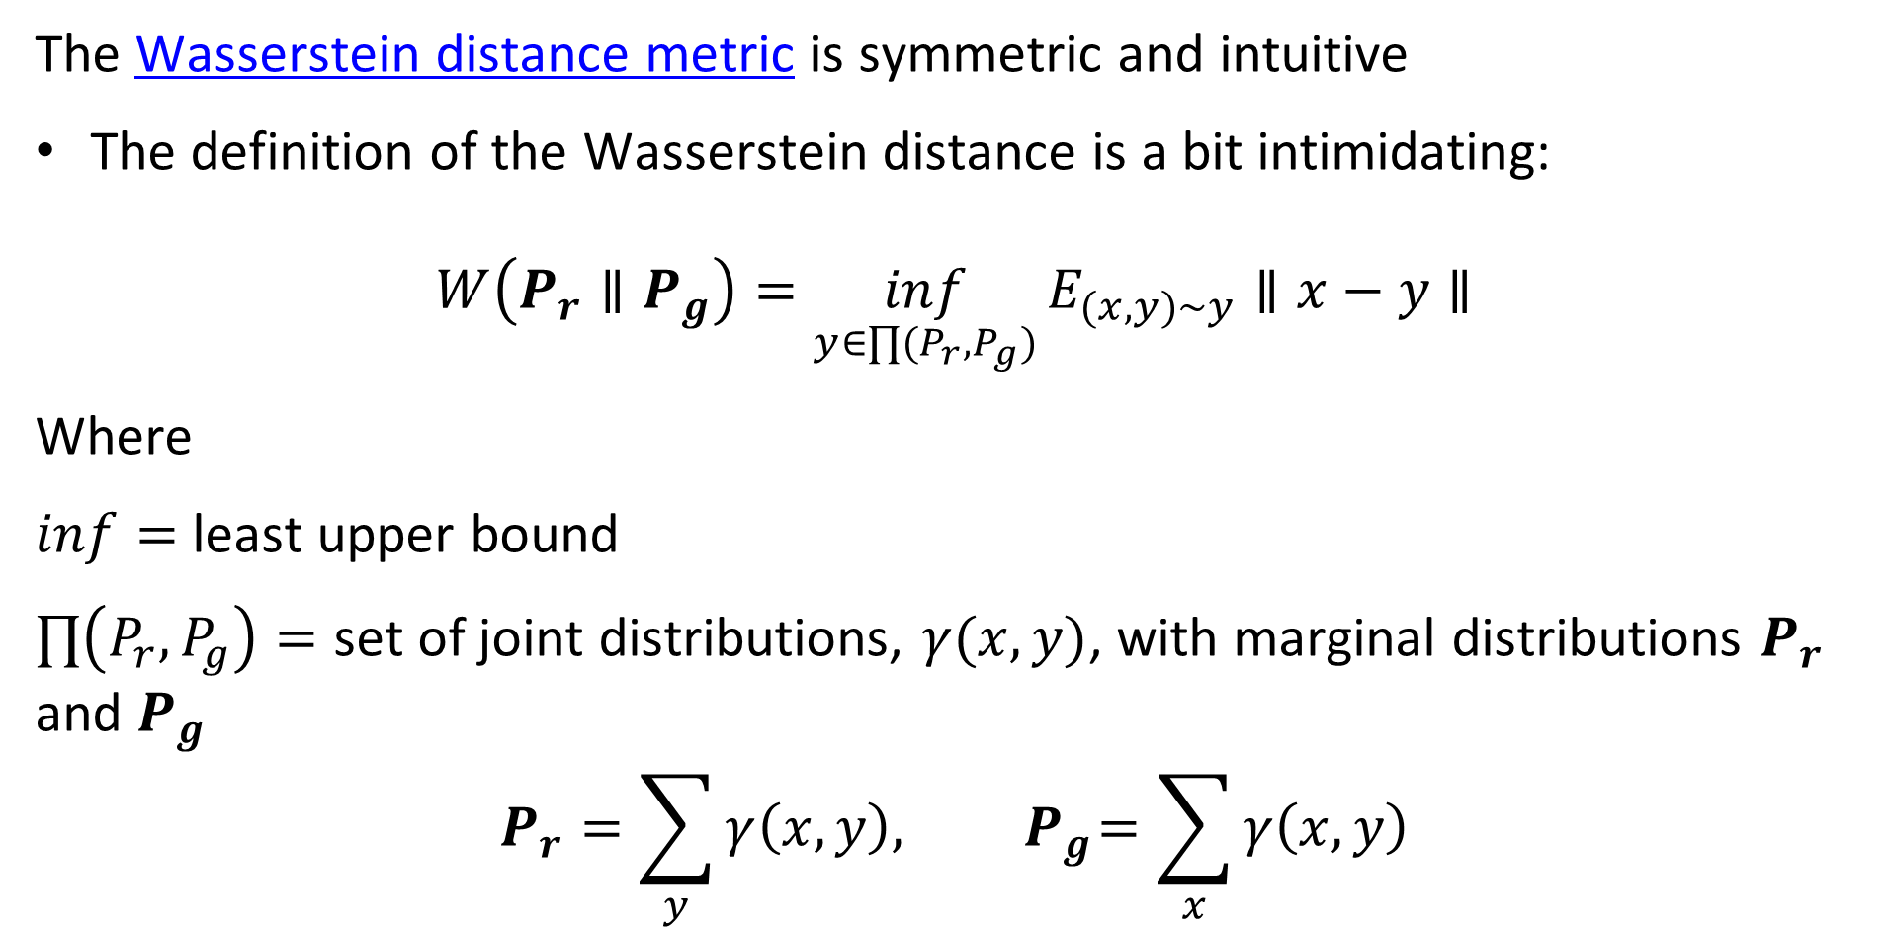
The Wasserstein distance metric
The Wasserstein distance metric is symmetric and intuitive
The definition of the Wasserstein distance is a bit intimidating:
$$W\left(P_{r}∥P_{g}\right)=\inf_{y∈∏(P_{r},P_{g})}{E_{(x,y)∼y}∥x−y∥}$$
Where
$inf=$ least upper bound
$∏\left(P_{r},P_{g}\right)=$ set of joint distributions, $γ(x,y)$, with marginal distributions $P_{r}$ and $P_{g}$
$$P_{r}=\sum_{y}{γ\left(x,y\right),{ P}_{g}=\sum_{x}{γ\left(x,y\right)}}$$

Slide 29
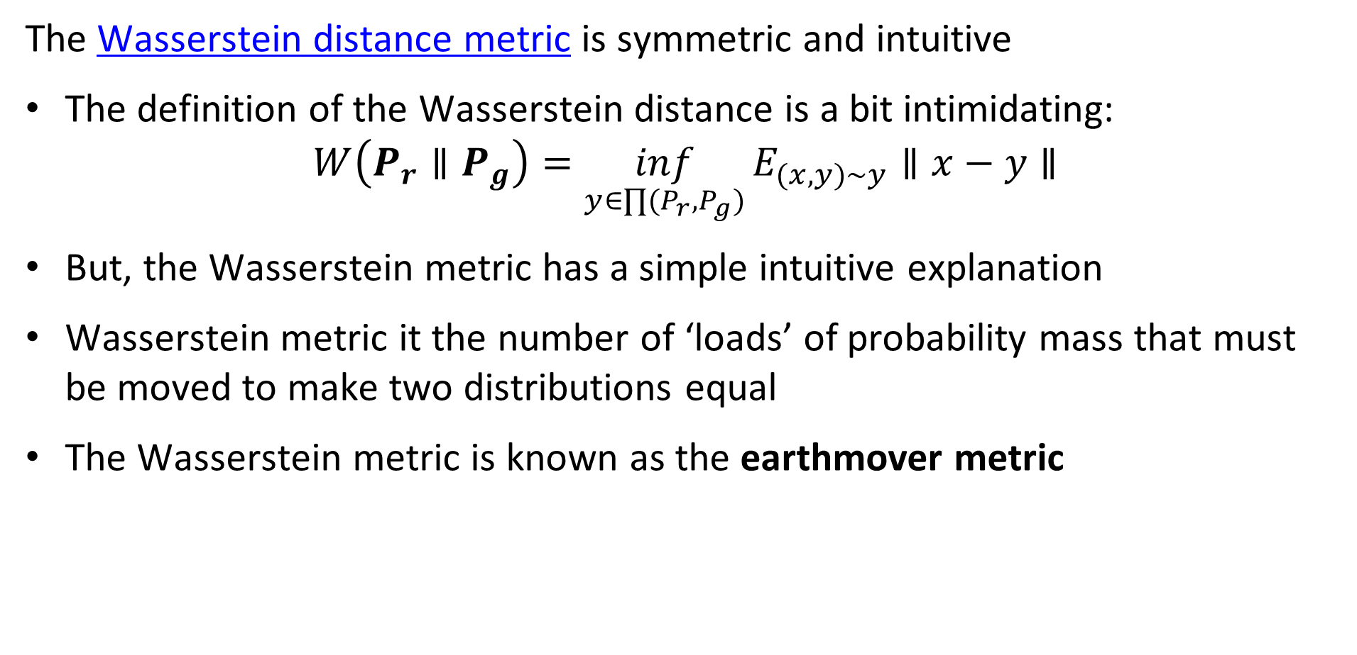
The Wasserstein distance metric
The Wasserstein distance metric is symmetric and intuitive
The definition of the Wasserstein distance is a bit intimidating:
$$W\left(P_{r}∥P_{g}\right)=\inf_{y∈∏(P_{r},P_{g})}{E_{(x,y)∼y}∥x−y∥}$$
But, the Wasserstein metric has a simple intuitive explanation
Wasserstein metric it the number of ‘loads’ of probability mass that must be moved to make two distributions equal
The Wasserstein metric is known as the earthmover metric

Slide 30
The Wasserstein distance metric
How many earthmover loads are required to equalize the distributions?
4
4
4
4
Q(x)
3
3
3
3
2
2
2
2
1
1
1
1
0
1
2
3
4
0
1
2
3
4
0
1
2
3
4
0
1
2
3
4
4
4
4
4
3
3
3
3
P(x)
2
2
2
2
1
1
1
1
0
1
2
3
4
0
1
2
3
4
0
1
2
3
4
0
1
2
3
4
0 loads
1 load
2 loads
3 loads

Slide 31
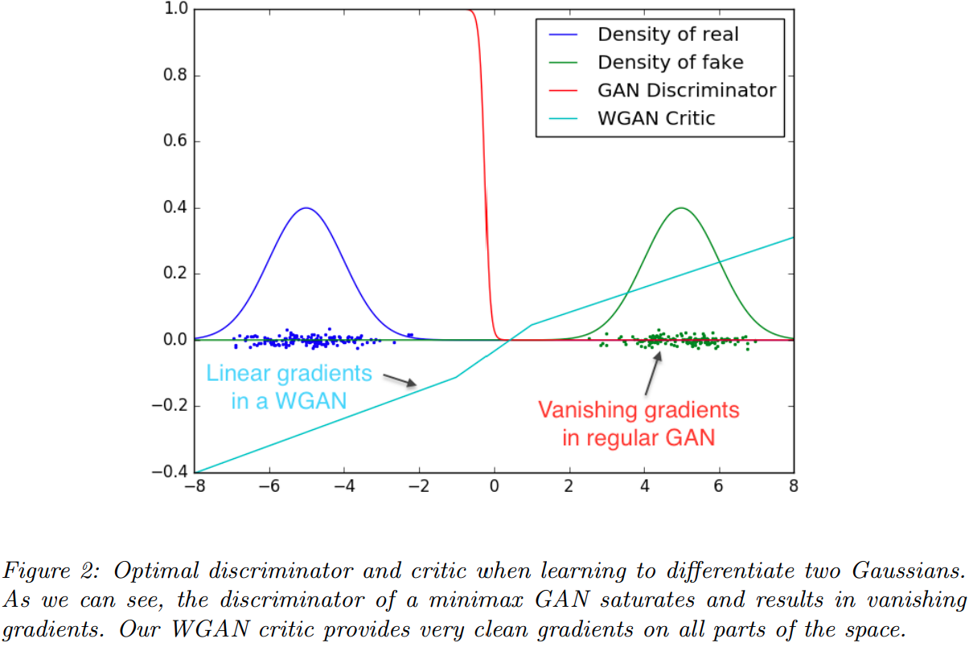
The Wasserstein distance metric
The loss of the Wasserstein GAN is linear and symmetric
The KL divergence of the real and generated data can be discontinuous and have 0 derivatives
The Wasserstein loss has linear gradient

Slide 32
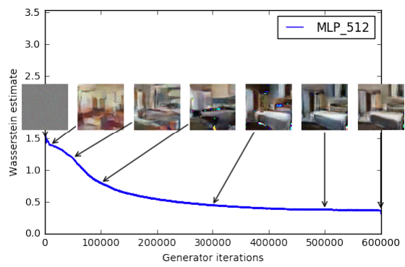
The Wasserstein distance metric
The loss of the Wasserstein GAN is linear and symmetric
Image generation starts with random noise
As generator loss is reduced, the images create improve
Notice that learning continues as loss function continues to decrease

Slide 33
Evaluation of GANs
Need an objective metric for evaluation of GAN models
Early GAN research inhibited by use of only subjective human judgement
Need an objective evaluation metric that agrees with human judgement of generated image quality
Inception score was proposed by Salimans, et. al., 2016
Fréchet Inception distance proposed by Heusel, et. al., 2017 is an improvement on inception score

Slide 34
Evaluation of GANs
Inception score attempts to balance accuracy at creating real objects and diversity of objects created
Inception score is based on classifications by the pre-trained Inception Network
GANs should produce object images that closely resemble real-world objects
Inception should clearly recognize objects
Classification probabilities should have only one high value
Poorly recognized objects have indeterminant probabilities
GANs should produce a diversity of objects – not the same few many times
Should be a nearly uniform distribution of probability of occurrence of each recognized object class

Slide 35
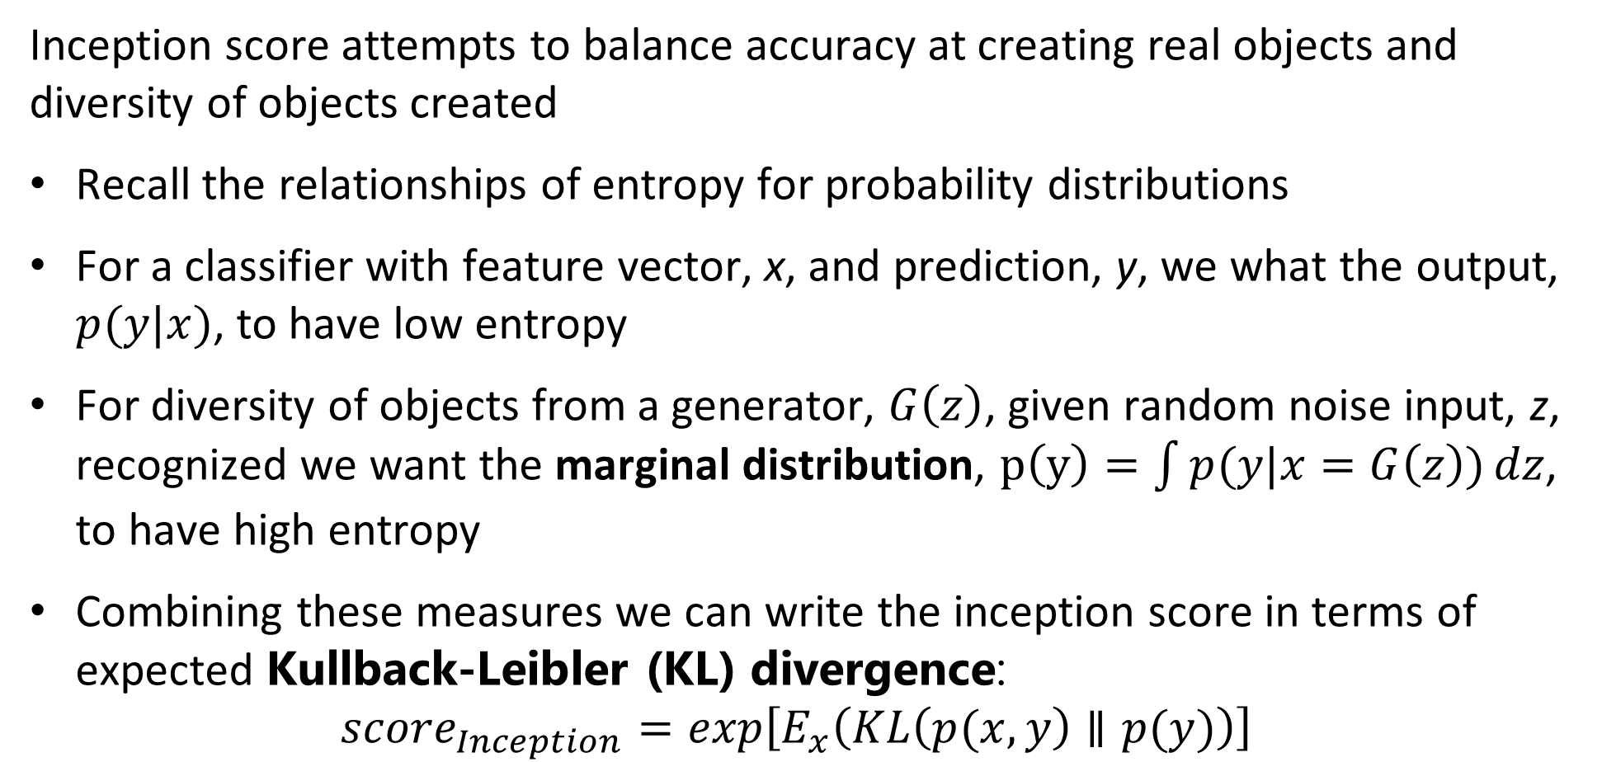
Evaluation of GANs
Inception score attempts to balance accuracy at creating real objects and diversity of objects created
Recall the relationships of entropy for probability distributions
For a classifier with feature vector, x, and prediction, y, we what the output, $p(y|x)$, to have low entropy
For diversity of objects from a generator, $G\left(z\right)$, given random noise input, z, recognized we want the marginal distribution, $p\left(y\right)=\int{p(y|x=G\left(z\right))}dz$, to have high entropy
Combining these measures we can write the inception score in terms of expected Kullback-Leibler (KL) divergence:
$${score}_{Inception}=exp\left[E_{x}\left(KL\left(p(x,y\right)∥p(y)\right)\right]$$

Slide 36
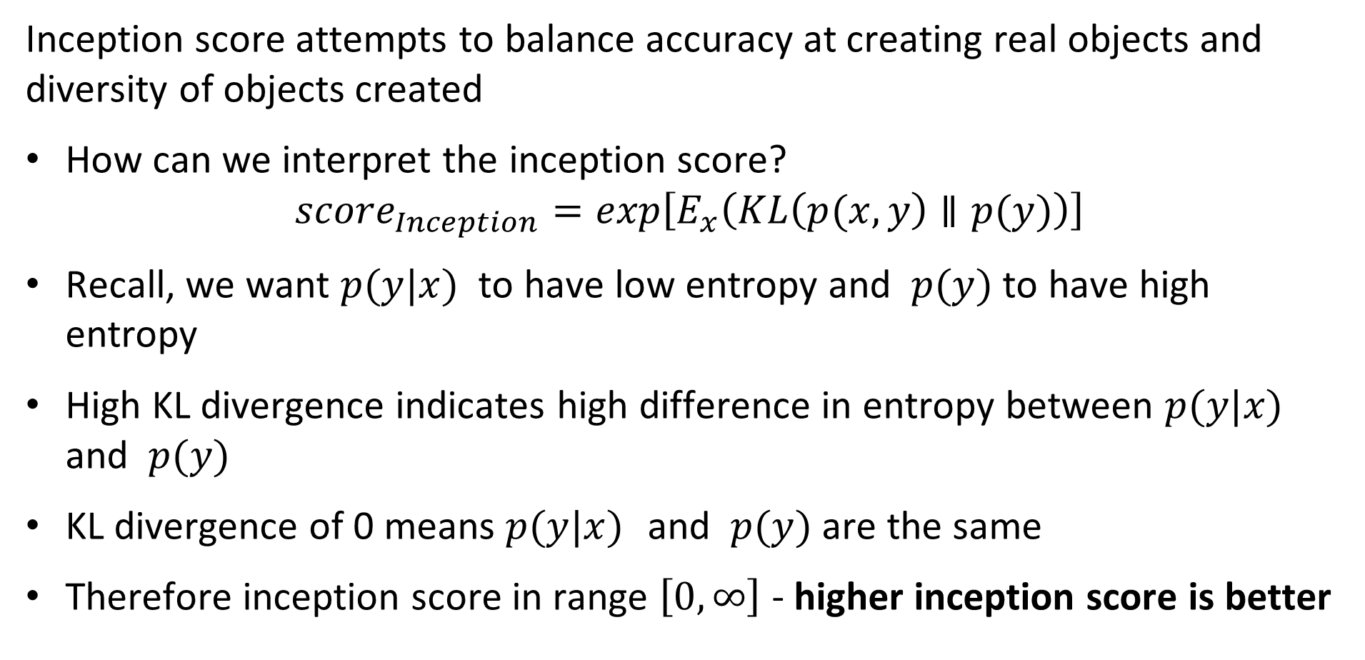
Evaluation of GANs
Inception score attempts to balance accuracy at creating real objects and diversity of objects created
How can we interpret the inception score?
$${score}_{Inception}=exp\left[E_{x}\left(KL\left(p(x,y\right)∥p(y)\right)\right]$$
Recall, we want $p(y|x)$ to have low entropy and $p(y)$ to have high entropy
High KL divergence indicates high difference in entropy between $p(y|x)$ and $p(y)$
KL divergence of 0 means $p(y|x)$ and $p(y)$ are the same
Therefore inception score in range $\left[0,∞\right]$ - higher inception score is better

Slide 37
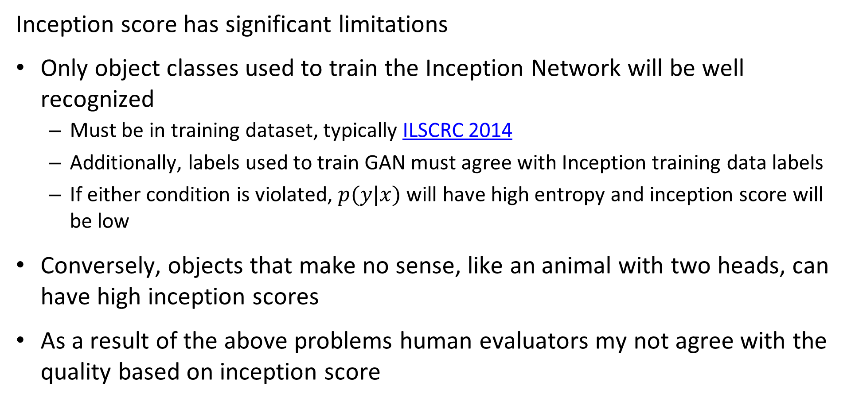
Evaluation of GANs
Inception score has significant limitations
Only object classes used to train the Inception Network will be well recognized
Must be in training dataset, typically ILSCRC 2014
Additionally, labels used to train GAN must agree with Inception training data labels
If either condition is violated, $p(y|x)$ will have high entropy and inception score will be low
Conversely, objects that make no sense, like an animal with two heads, can have high inception scores
As a result of the above problems human evaluators my not agree with the quality based on inception score

Slide 38
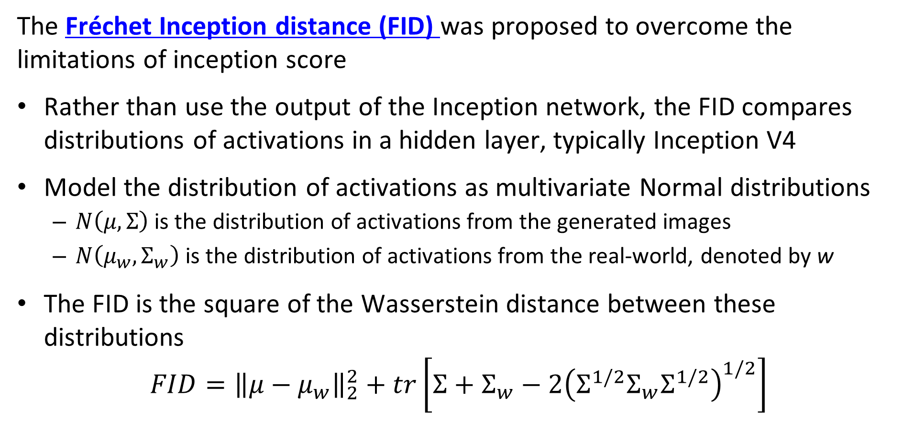
Evaluation of GANs
The Fréchet Inception distance (FID) was proposed to overcome the limitations of inception score
Rather than use the output of the Inception network, the FID compares distributions of activations in a hidden layer, typically Inception V4
Model the distribution of activations as multivariate Normal distributions
$N\left(μ,Σ\right)$ is the distribution of activations from the generated images
$N\left(μ_{w},Σ_{w}\right)$ is the distribution of activations from the real-world, denoted by w
The FID is the square of the Wasserstein distance between these distributions
$$FID={\left\|μ−μ_{w}\right\|}_{2}^{2}+tr\left[Σ+Σ_{w}−2{\left(Σ^{1/2}Σ_{w}Σ^{1/2}\right)}^{1/2}\right]$$

Slide 39
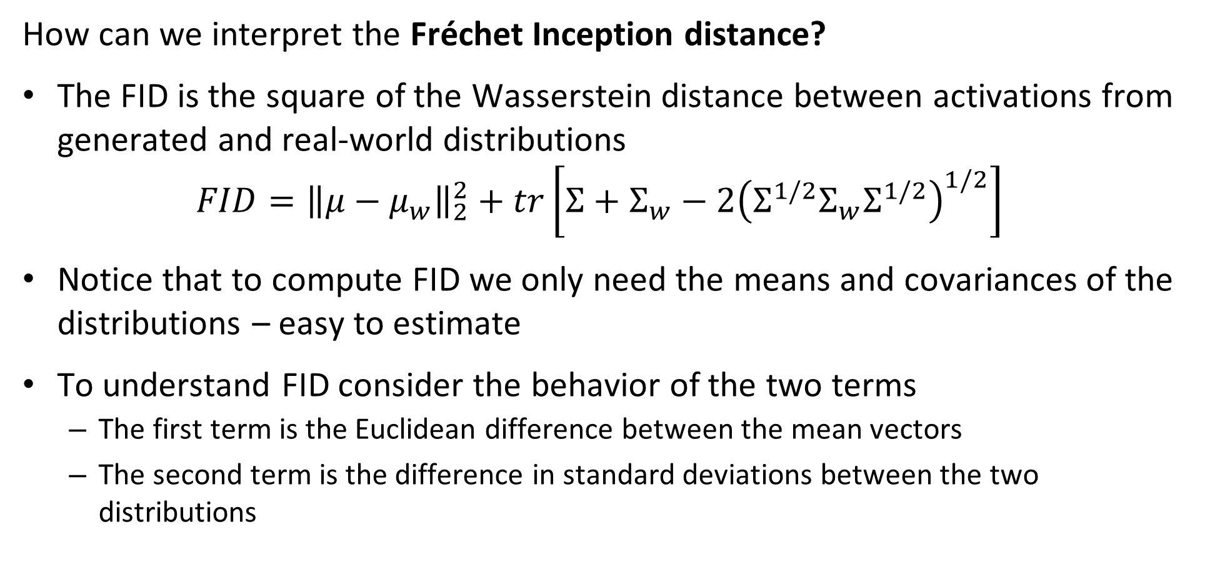
Evaluation of GANs
How can we interpret the Fréchet Inception distance?
The FID is the square of the Wasserstein distance between activations from generated and real-world distributions
$$FID={\left\|μ−μ_{w}\right\|}_{2}^{2}+tr\left[Σ+Σ_{w}−2{\left(Σ^{1/2}Σ_{w}Σ^{1/2}\right)}^{1/2}\right]$$
Notice that to compute FID we only need the means and covariances of the distributions – easy to estimate
To understand FID consider the behavior of the two terms
The first term is the Euclidean difference between the mean vectors
The second term is the difference in standard deviations between the two distributions

Slide 40
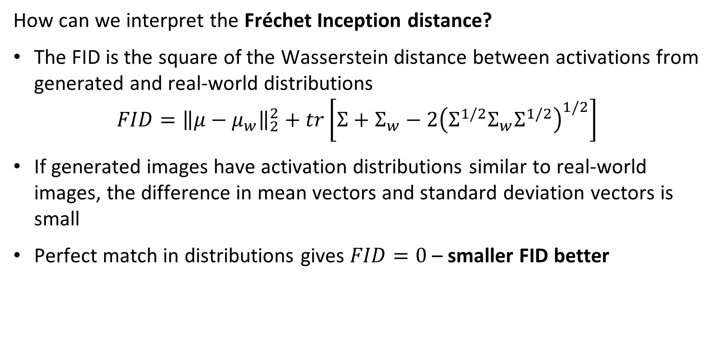
Evaluation of GANs
How can we interpret the Fréchet Inception distance?
The FID is the square of the Wasserstein distance between activations from generated and real-world distributions
$$FID={\left\|μ−μ_{w}\right\|}_{2}^{2}+tr\left[Σ+Σ_{w}−2{\left(Σ^{1/2}Σ_{w}Σ^{1/2}\right)}^{1/2}\right]$$
If generated images have activation distributions similar to real-world images, the difference in mean vectors and standard deviation vectors is small
Perfect match in distributions gives $FID=0$ – smaller FID better

Slide 41
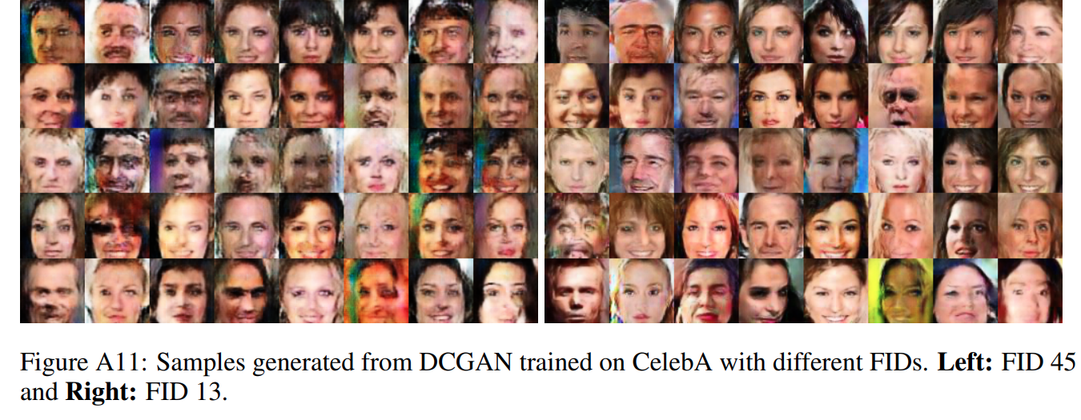
Evaluation of GANs
Example of Fréchet Inception distance – agrees with human perception

Slide 42
Approaches to improved GAN training
A great deal of research has focused on improving the convergence and preventing mode collapse, an incomplete list of key advances:
Method | Approach | Year
Conditional GAN | Output conditioned on the image label | 2015
Deep Convolutional GANs - DC-GANs | Use fully convolutional representation | 2016
Multiple ad-hoc methods, Salimans, et. al., 2016 | Minibatch mixing, virtual batch normalization, and feature matching – Rarely used now days, beyond inception score | 2016
Wasserstein GAN | Use Wasserstein loss for training | 2017
Two-time scale updates | Use different time scales for generator and discriminator training | 2018
Spectral Normalization – SN-GANs | Scale weights so largest eigenvalue to 1.0 | 2018
Self Attention GAN - SAGAN | Use an self attention mechanism to train latent space | 2019
Style-based GAN | Generator uses attention on specific parts of the latent space to create desired style, see Karras, et.al., 2018 for details | 2018

Slide 43
Conditional GANs use labels
Mirza and Osindero, 2014, use label data to condition GAN generation
Loss function did not depend on category of image being generated in early GAN architectures
The output depends on label of desired category
Example: If label = ‘0’, generated image should look like the numeral 0
Example: If label = ‘cat’, generated image should look like a cat
Loss function conditioned on one-hot encoded label vector
Improves generated images
Reduces training time

Slide 44
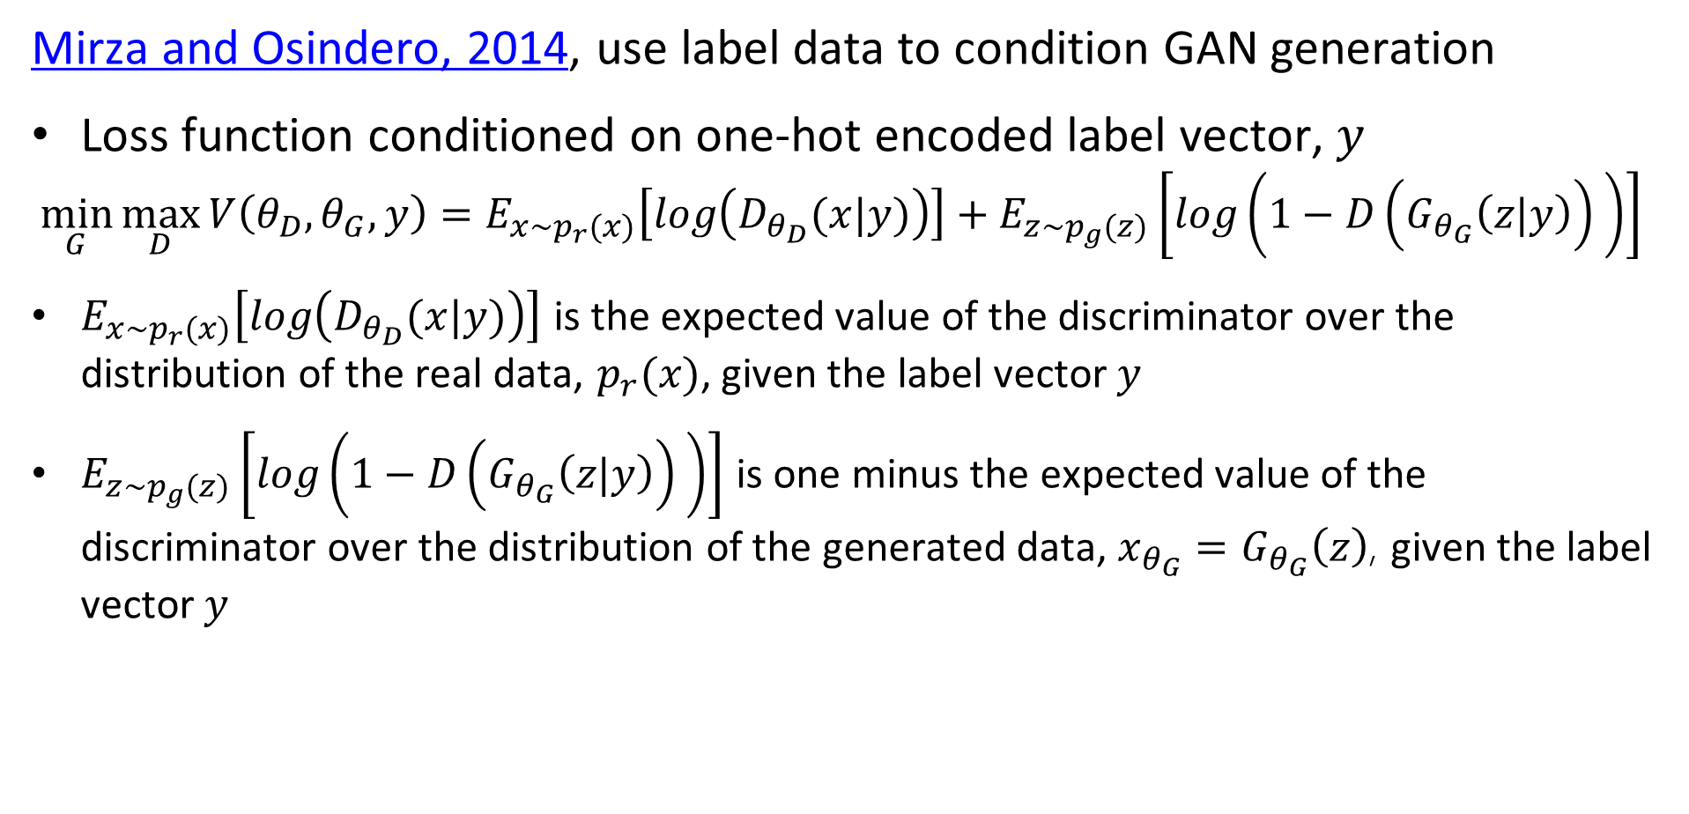
Conditional GANs use labels
Mirza and Osindero, 2014, use label data to condition GAN generation
Loss function conditioned on one-hot encoded label vector, $y$
$$\min_{G}{\max_{D}{V\left(θ_{D},θ_{G},y\right)=E_{x\sim p_{r}(x)}\left[log\left(D_{θ_{D}}(x|y)\right)\right]+E_{z\sim p_{g}(z)}\left[log\left({1−D\left(G_{θ_{G}}\left(z|y\right)\right)}_{ }\right)\right] }}$$
$E_{x\sim p_{r}(x)}\left[log\left(D_{θ_{D}}(x|y)\right)\right]$ is the expected value of the discriminator over the distribution of the real data, $p_{r}(x)$, given the label vector $y$
$E_{z\sim p_{g}(z)}\left[log\left({1−D\left(G_{θ_{G}}\left(z|y\right)\right)}_{ }\right)\right]$ is one minus the expected value of the discriminator over the distribution of the generated data, $x_{θ_{G}}=G_{θ_{G}}\left(z\right)$, given the label vector $y$

Slide 45
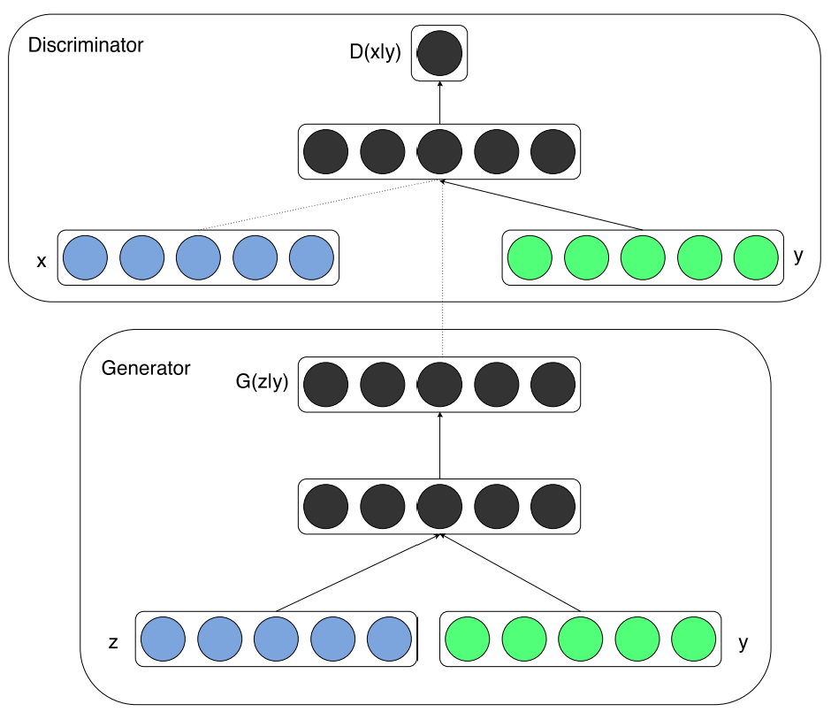
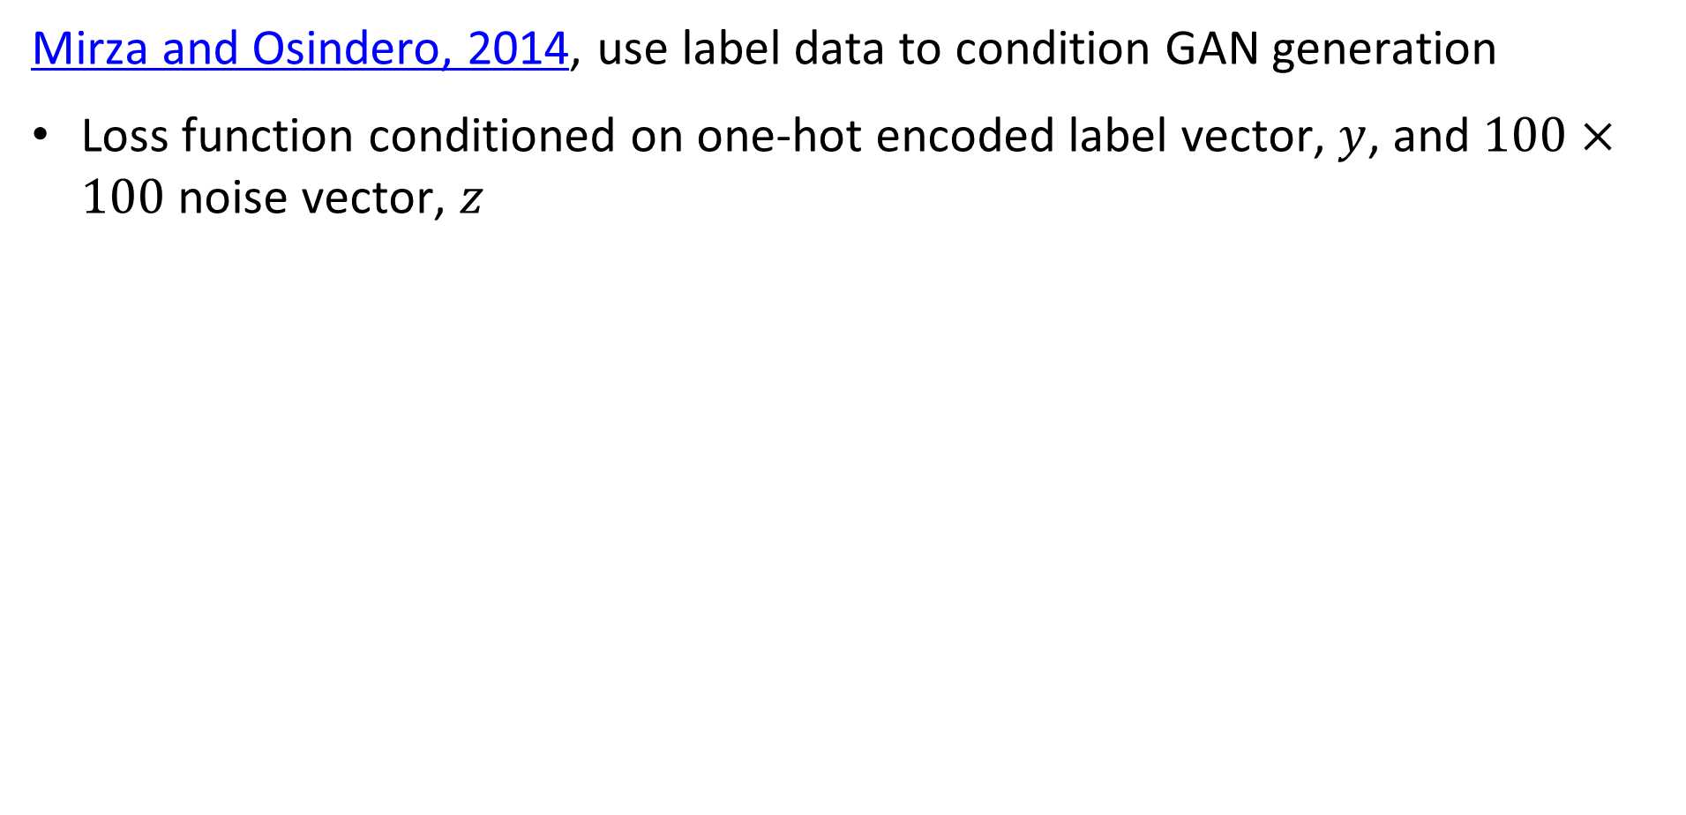
Conditional GANs use labels
Mirza and Osindero, 2014, use label data to condition GAN generation
Loss function conditioned on one-hot encoded label vector, $y$, and $100×100$ noise vector, $z$

Slide 46
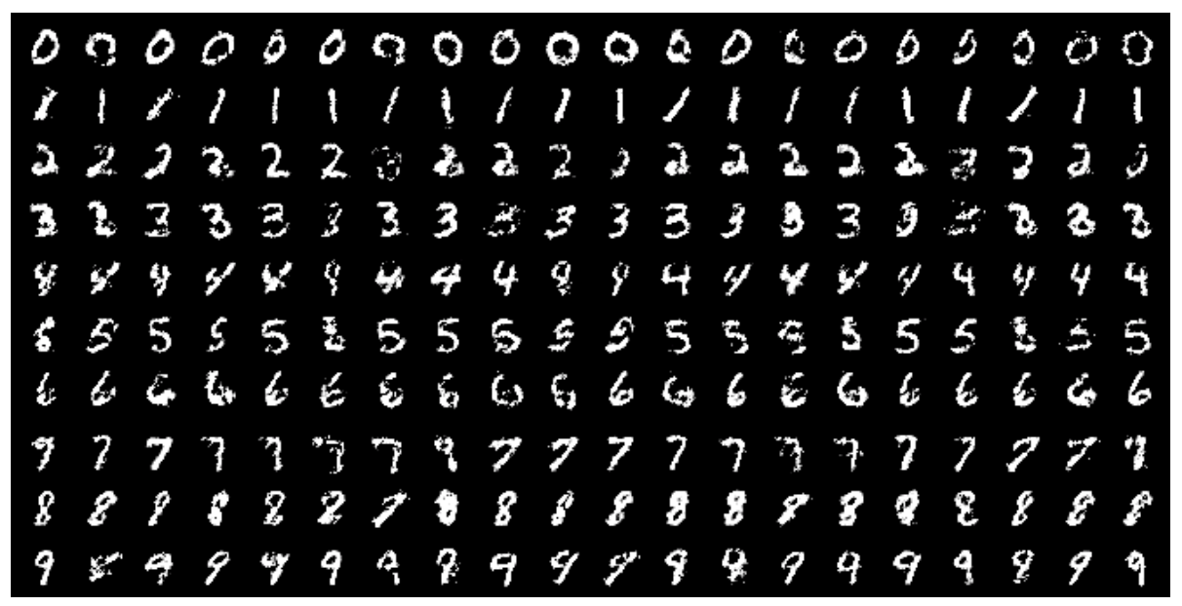
Conditional GANs use labels
Mirza and Osindero, 2014, use label data to condition GAN generation
Example of generated images
Mini-batch size = 100
Learning rate decreased from 0.1 to .000001
Momentum increased 0.5 to 0.7
Dropout probability = 0.5

Slide 47
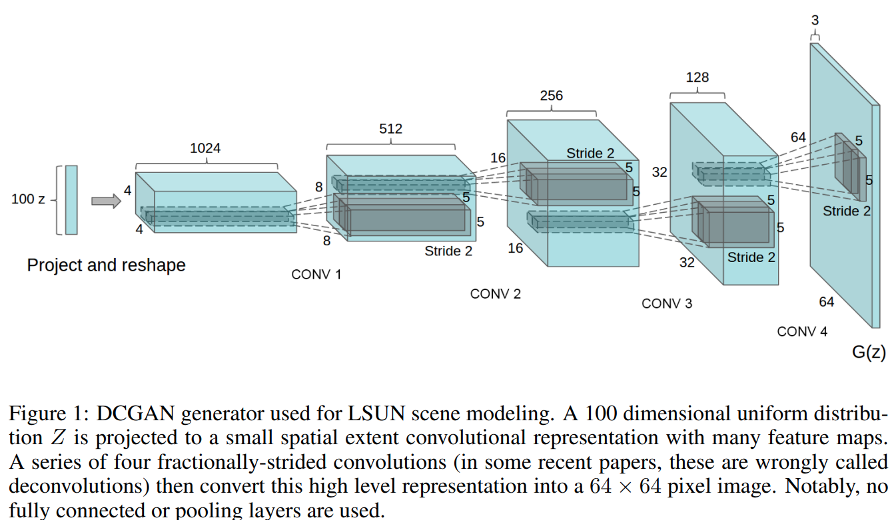
The Convolutional GAN
The deep convolutional GAN is a fully convolutional
The deep convolutional GAN or DCGAN (Radford, et. al. 2015) was a significant breakthrough in creating GAN model with stable training behavior
Fully convolutional architecture – no fully connected layers

Slide 48
The Convolutional GAN
Components of the DCGAN
Convolutional Embedding Space
Increasing image resolution
Random Input vector

Slide 49
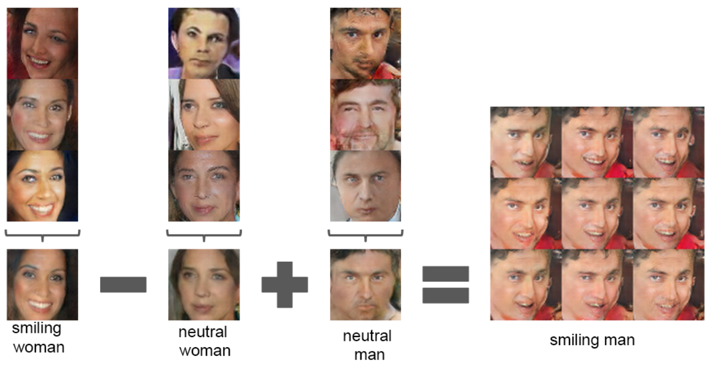
The Convolutional GAN
Can perform linear mathematical operations on convolutional embedding space

Slide 50
Example: Colorizing images
Nazieri, et. al, 2018, used deep convolutional conditional GAN architecture to colorize images
Goal, to convert gray-scale image to color
Fully convolutional architecture, no pooling
Training data easy to create; convert image to gray-scale
Also see the code and examples in Github

Slide 51
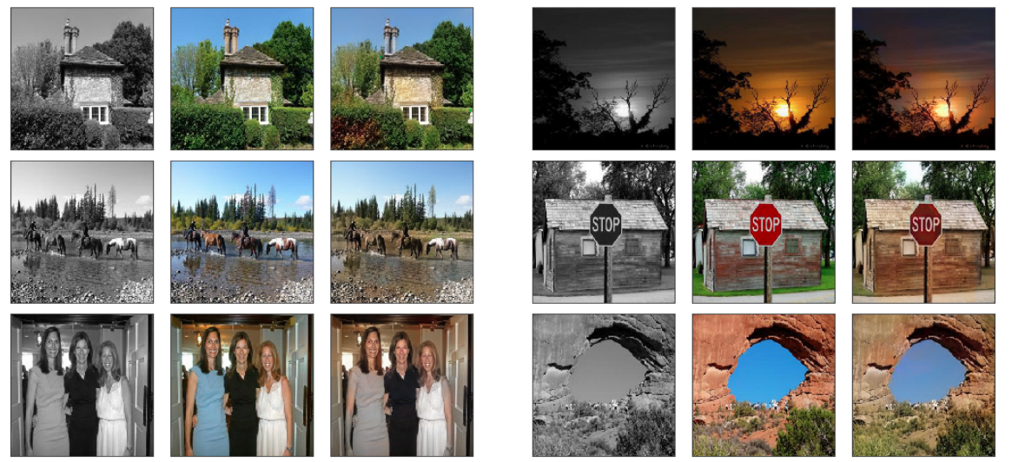
Example: Colorizing images
Examples of colorize images:
Gray-scale
Original
Generated
Gray-scale
Original
Generated
Encoder Layers

Slide 52
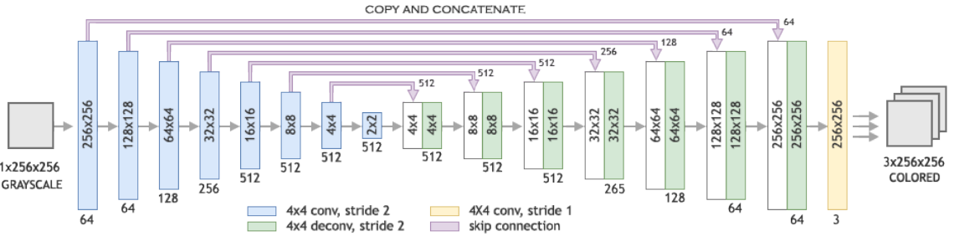
Example: Colorizing images
Nazieri, et. al, 2018, used deep convolutional conditional GAN architecture to colorize images
Generator uses deep encoder-decoder architecture
Encoder Layers
Decoder Layers

Slide 53
GANs trained with two time scales
Heusel, et. al, 2018, use two time scale update rule (TTUR) train the discriminator and generator
Observer that simple generator-discriminator training may only converge to a local Nash equilibrium – no global convergence guarantee
Discriminator learns too fast
Discriminator learns to tell real from generated data
Generator is prevented from further learning
Solution, limit learning rates to guarantee convergence toward global Nash equilibrium
Heusel, et. al, 2018 also introduced the Fréchet Inception distance

Slide 54
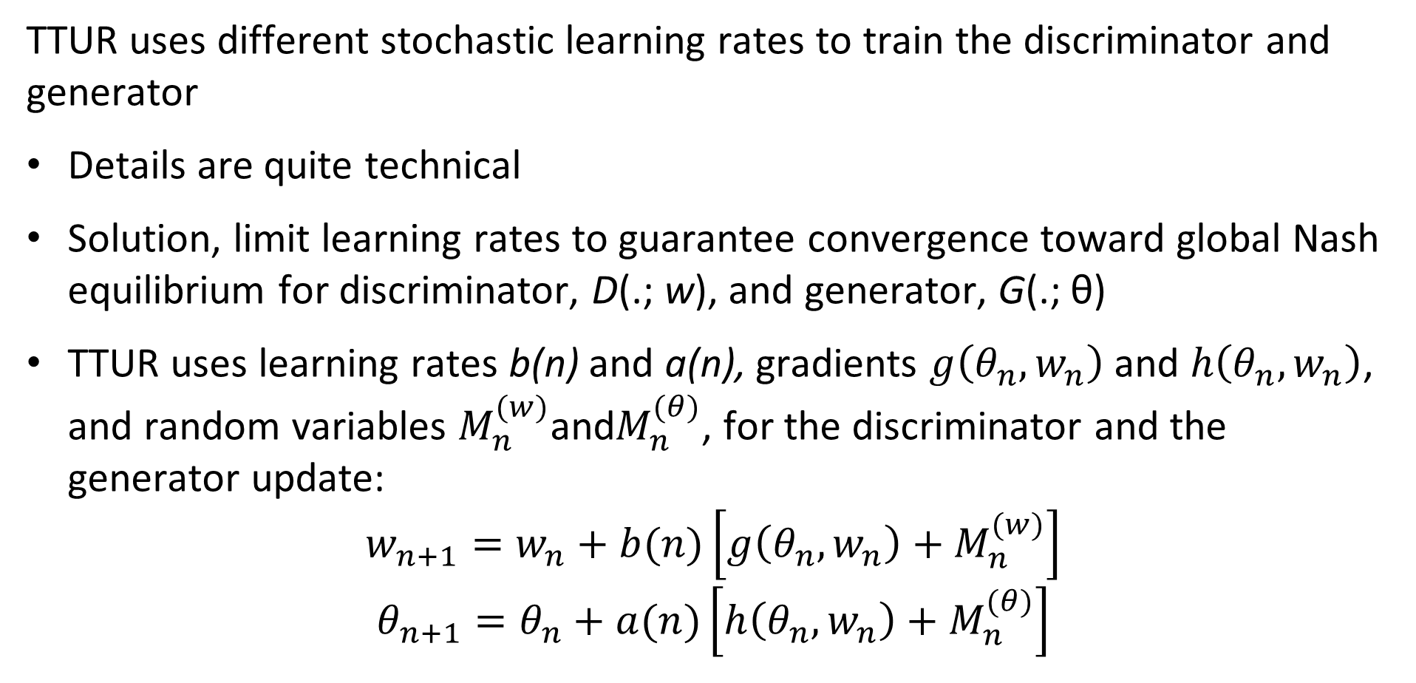
GANs trained with TTUR
TTUR uses different stochastic learning rates to train the discriminator and generator
Details are quite technical
Solution, limit learning rates to guarantee convergence toward global Nash equilibrium for discriminator, D(.; w), and generator, G(.; θ)
TTUR uses learning rates b(n) and a(n), gradients $g\left(θ_{n},w_{n}\right)$ and $h\left(θ_{n},w_{n}\right)$, and random variables $M_{n}^{(w)}$and$M_{n}^{(θ)}$, for the discriminator and the generator update:
$$w_{n+1}=w_{n}+b(n)\left[g\left(θ_{n},w_{n}\right)+M_{n}^{(w)}\right]$$
$$θ_{n+1}=θ_{n}+a(n)\left[h\left(θ_{n},w_{n}\right)+M_{n}^{(θ)}\right]$$

Slide 55
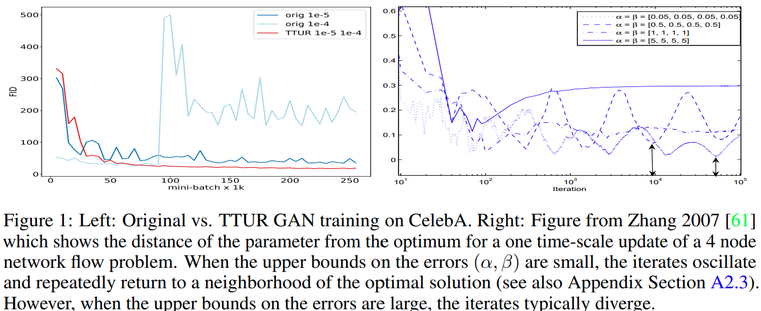
GANs trained with TTUR
TTUR uses different stochastic learning rates to train the discriminator and generator

Slide 56
Spectral normalization of weights
Many types of regularization have been tried for GANs
Weight clipping, L1 regularization, L2 regularization, batch/weight normalization, dropout regularization
Regularization often inhibits learning by discriminator
Miyato, et. al., 2018, applied spectral normalization to create the SN-GAN algorithm - a quite technical, but interesting, paper
SN-GAN algorithm employs TTUR rule along with spectral normalization for training discriminator and generator

Slide 57
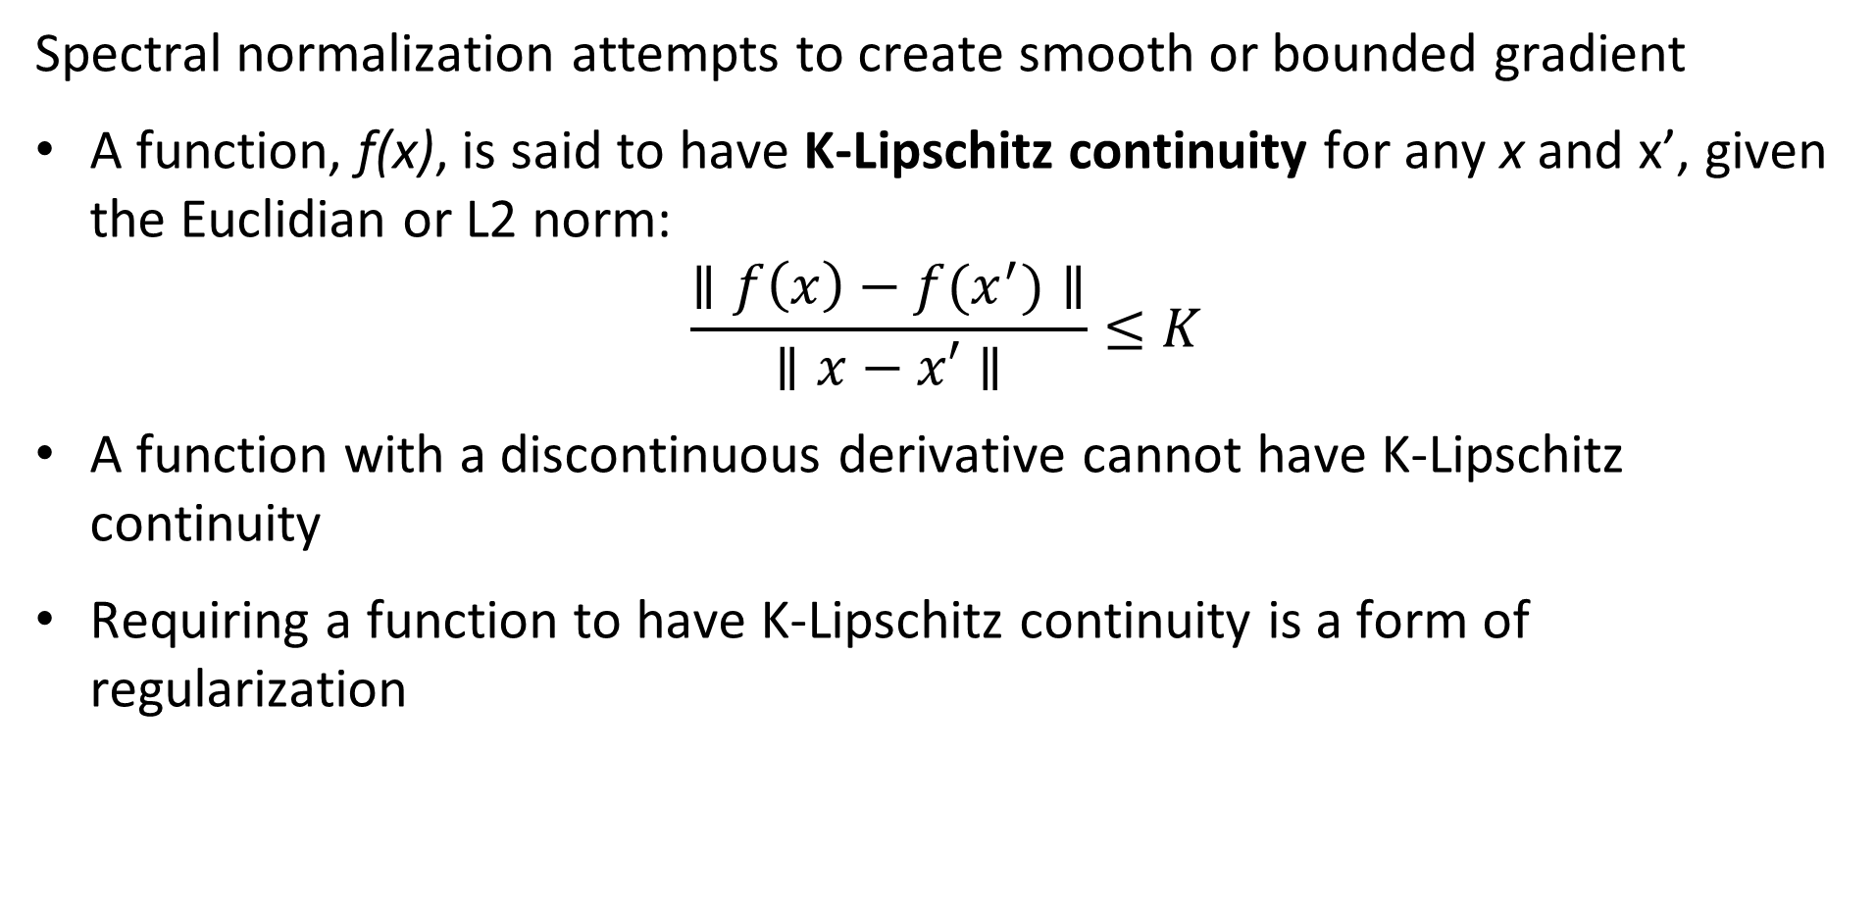
Spectral normalization of weights
Spectral normalization attempts to create smooth or bounded gradient
A function, f(x), is said to have K-Lipschitz continuity for any x and x’, given the Euclidian or L2 norm:
$$\frac{∥f\left(x\right)−f(x^{′})∥}{∥x−x′∥}≤K$$
A function with a discontinuous derivative cannot have K-Lipschitz continuity
Requiring a function to have K-Lipschitz continuity is a form of regularization

Slide 58
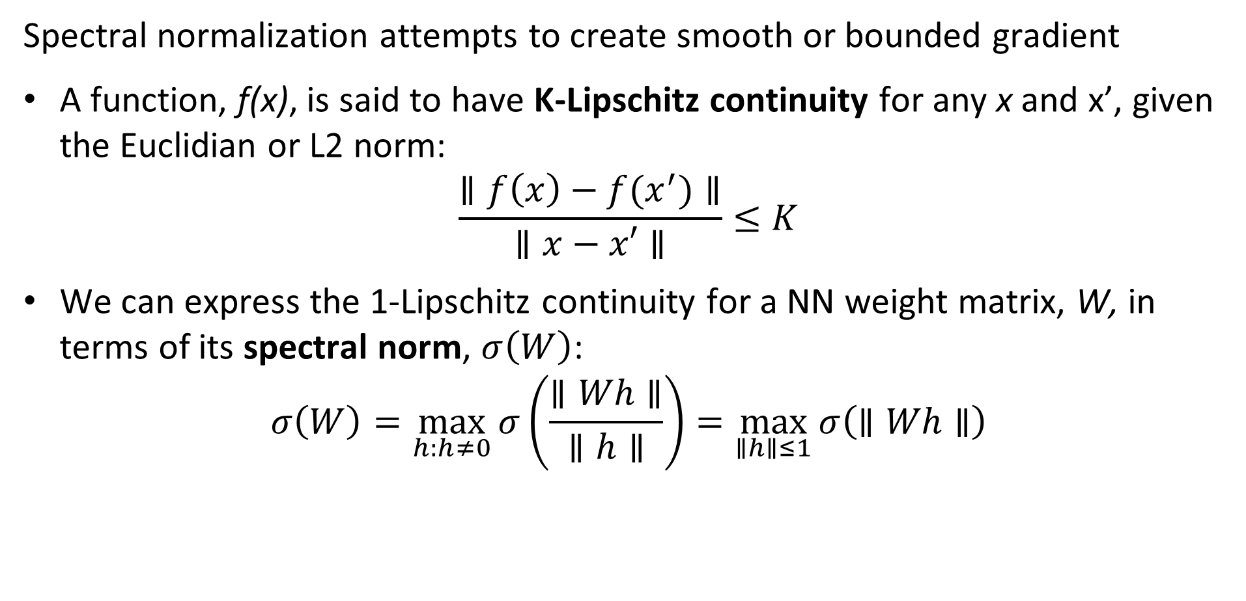
Spectral normalization of weights
Spectral normalization attempts to create smooth or bounded gradient
A function, f(x), is said to have K-Lipschitz continuity for any x and x’, given the Euclidian or L2 norm:
$$\frac{∥f\left(x\right)−f(x^{′})∥}{∥x−x′∥}≤K$$
We can express the 1-Lipschitz continuity for a NN weight matrix, W, in terms of its spectral norm, $σ\left(W\right)$:
$$σ\left(W\right)=\max_{h:h≠0}{σ\left(\frac{∥Wh∥}{∥h∥}\right)}=\max_{∥h∥≤1}{σ\left(∥Wh∥\right)}$$

Slide 59
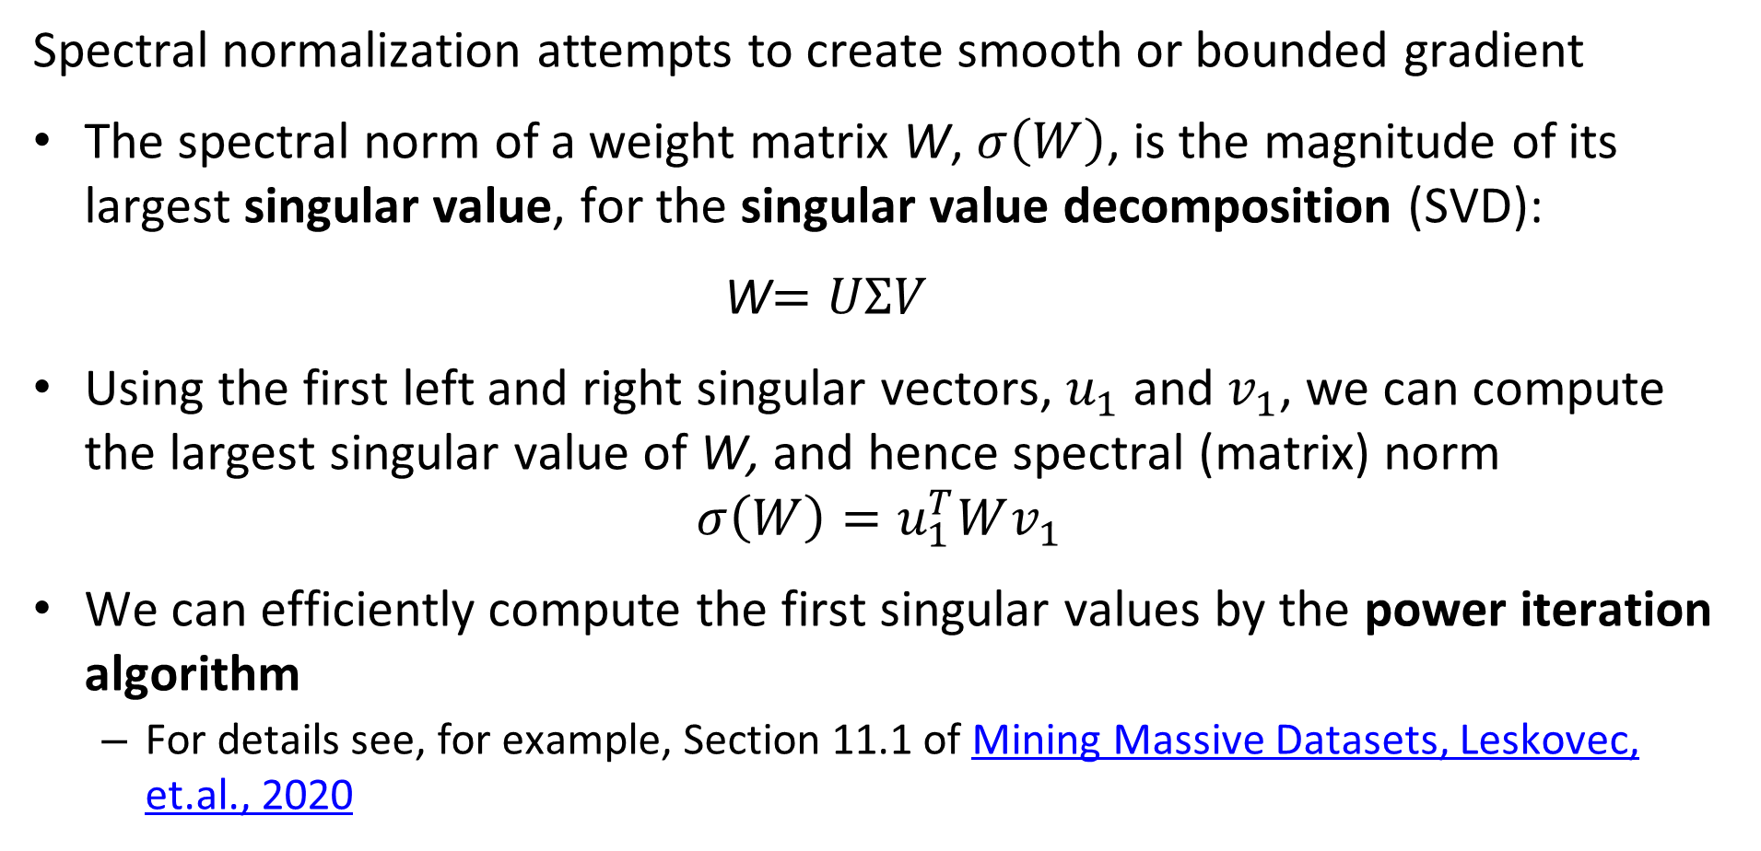
Spectral normalization of weights
Spectral normalization attempts to create smooth or bounded gradient
The spectral norm of a weight matrix W, $σ\left(W\right)$, is the magnitude of its largest singular value, for the singular value decomposition (SVD):
W$=UΣV$
Using the first left and right singular vectors, $u_{1}$ and $v_{1}$, we can compute the largest singular value of W, and hence spectral (matrix) norm
$$σ\left(W\right)=u_{1}^{T}Wv_{1}{ }$$
We can efficiently compute the first singular values by the power iteration algorithm
For details see, for example, Section 11.1 of Mining Massive Datasets, Leskovec, et.al., 2020

Slide 60
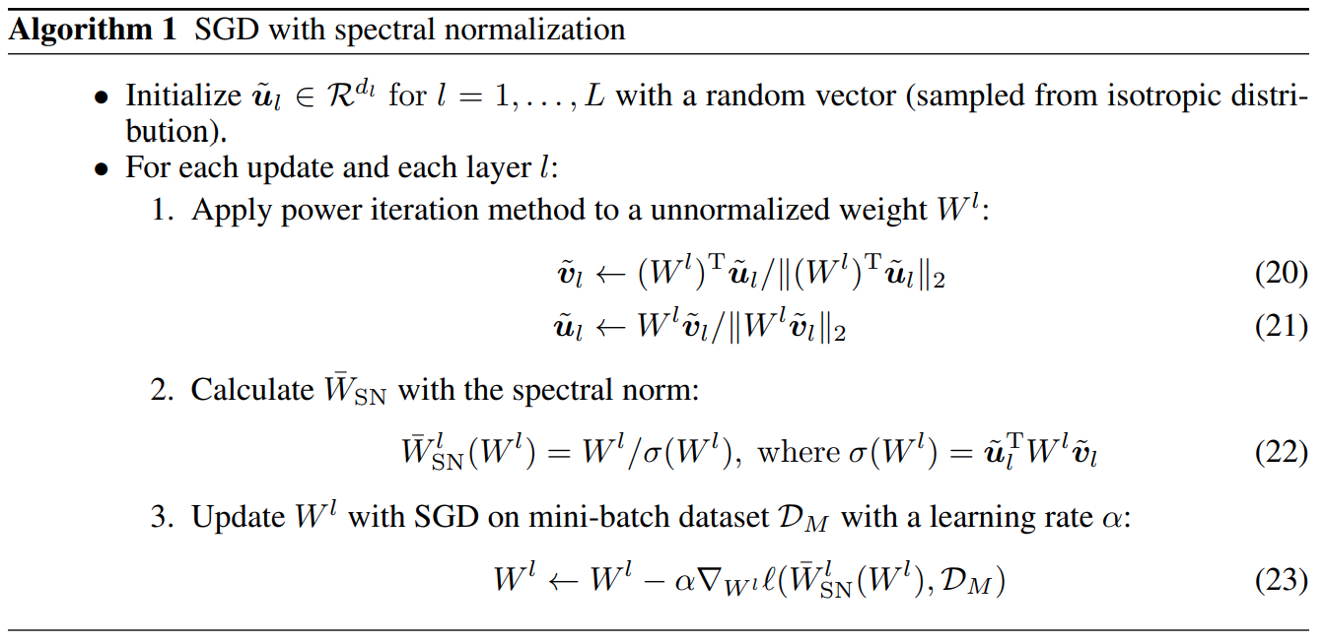
Spectral normalization of weights
The stochastic gradient descent (SGD) algorithm for SN-GAN is straight forward

Slide 61
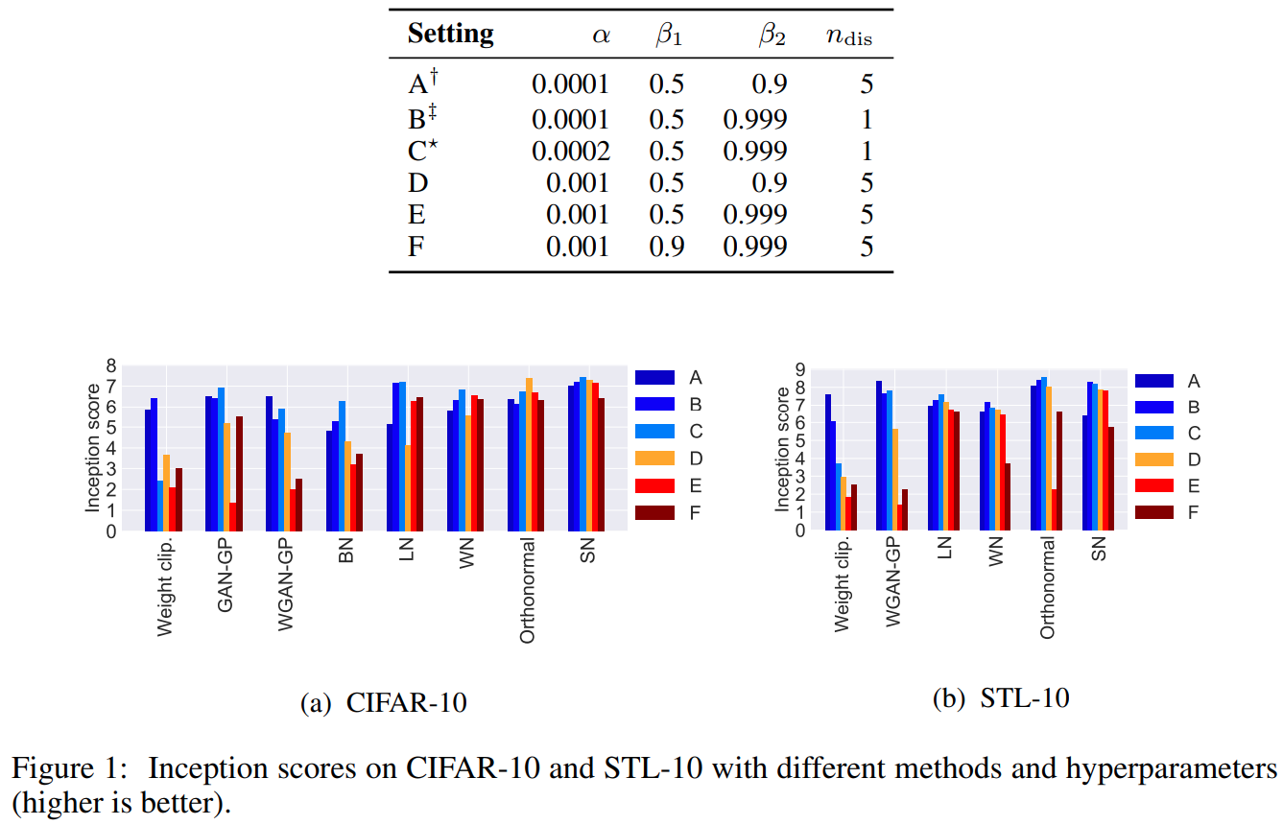
Spectral normalization of weights
Comparing inception scores of GAN models for different ADAM optimizer hyperparameters

Slide 62
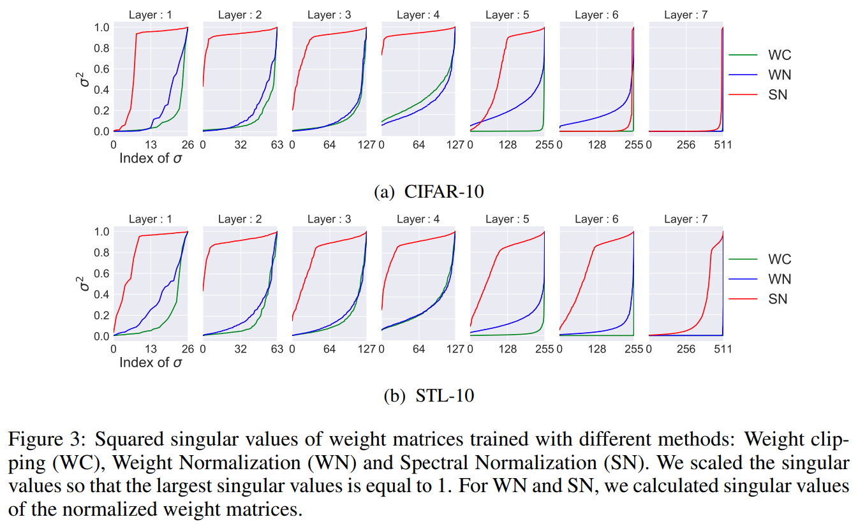
Spectral normalization of weights
Comparison of squared largest singular values for several regularization methods

Slide 63
Self-attention GAN
Images of real-world scenes have a significant spatial extent
Convolutional operators used to create an embedding (latent) space have a small spatial extent – receptive field
As a result of only local sensitivity, convolutional GANs are poor at creating many types of scenes
Wang, et. al., 2017, develop a non-local neural network algorithm using a self-attention mechanism which gives superior performance for several tasks
Zhang, et. al., 2019, applied non-local self-attention to training GANs

Slide 64
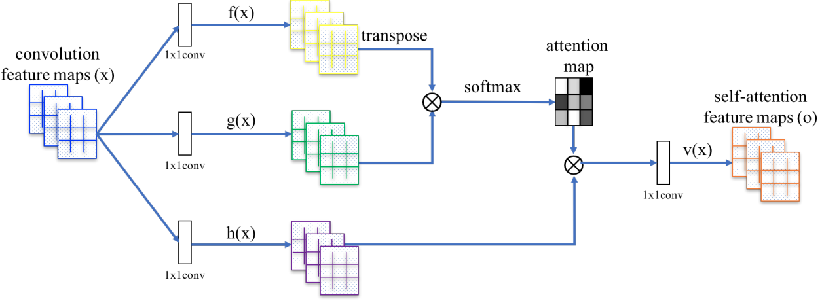
Self-attention GAN
Architecture of SA-GAN

Slide 65
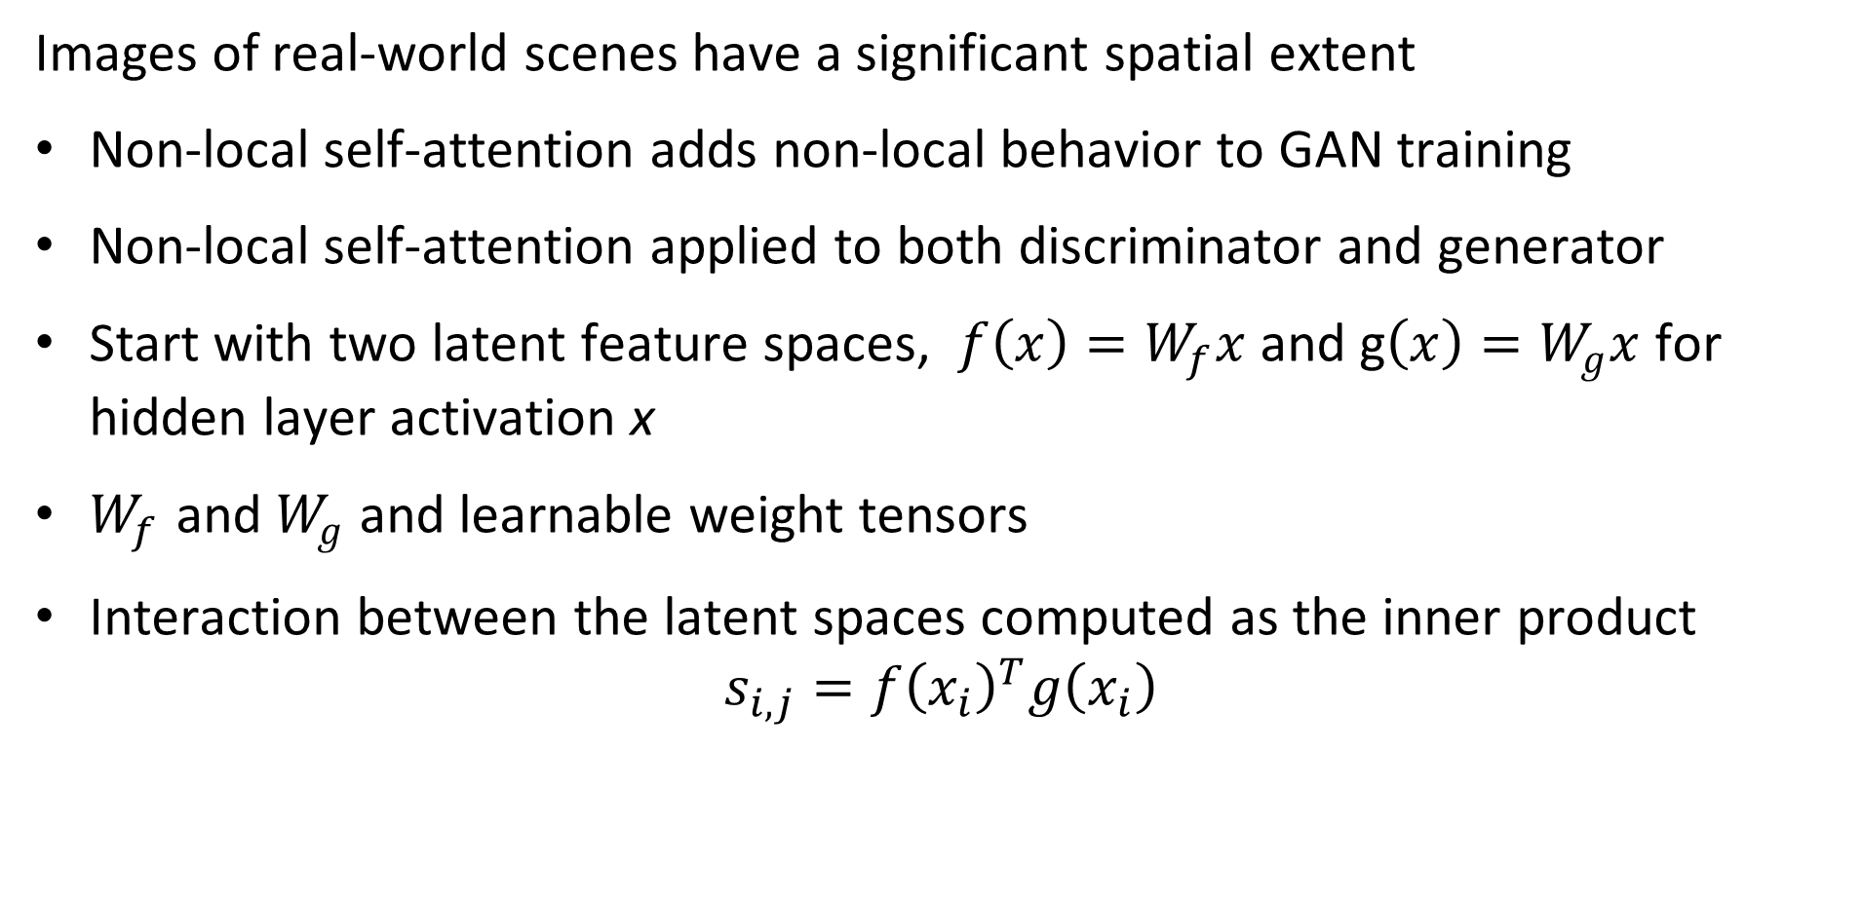
Self-attention GAN
Images of real-world scenes have a significant spatial extent
Non-local self-attention adds non-local behavior to GAN training
Non-local self-attention applied to both discriminator and generator
Start with two latent feature spaces, $f\left(x\right)=W_{f}x$ and g$\left(x\right)=W_{g}x$ for hidden layer activation x
$W_{f}$ and $W_{g}$ and learnable weight tensors
Interaction between the latent spaces computed as the inner product
$$s_{i,j}={f\left(x_{i}\right)}^{T}g\left(x_{i}\right)$$

Slide 66
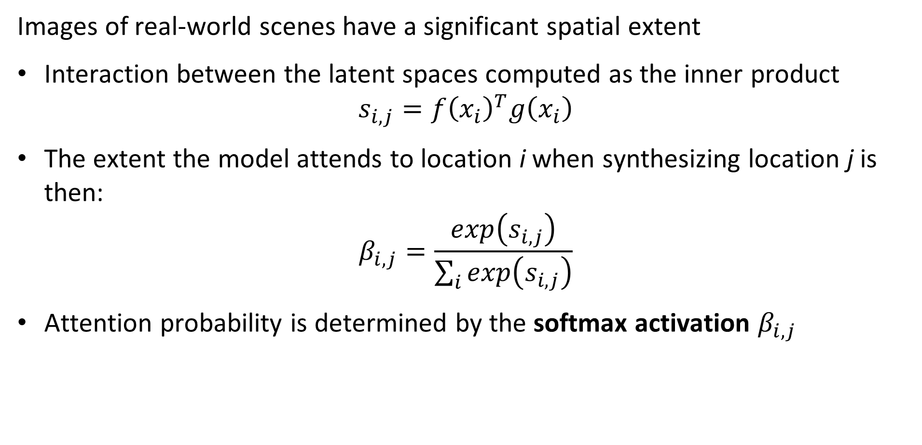
Self-attention GAN
Images of real-world scenes have a significant spatial extent
Interaction between the latent spaces computed as the inner product
$$s_{i,j}={f\left(x_{i}\right)}^{T}g\left(x_{i}\right)$$
The extent the model attends to location i when synthesizing location j is then:
$$β_{i,j}=\frac{exp\left(s_{i,j}\right)}{\sum_{i}{exp\left(s_{i,j}\right)}}$$
Attention probability is determined by the softmax activation $β_{i,j}$

Slide 67

Self-attention GAN
Images of real-world scenes have a significant spatial extent
The extent the model attends to location i when synthesizing location j, $β_{i,j}$
Output of attention layers is $o=\left(o_{1},o_{2,}…o_{n}\right)$, with learnable weight tensors, $W_{ν}$ and $W_{h}$:
$$o_{j}=ν\sum_{i=1}^{n}{β_{i,j}h\left(x_{i}\right)}, ν\left(x_{i}\right)=W_{ν}x_{i}, h\left(x_{i}\right)=W_{h}x_{i}$$
And the output of the GAN, , given learnable parameter, $γ$, is:
$$y_{i}=γo_{j}+x_{i}$$

Slide 68
Self-attention GAN
Architecture of SA-GAN

Slide 69

Self-attention GAN
Convergence properties of SA-GANs

Slide 70

Self-attention GAN
128x128 images generated by SA-GAN – FID of SA-GAN and SN-GAN shown

Slide 71

Summary
A generative model creates new data instances
Discriminative model discriminates between input data sequences
The generative model learns an embedding space with distribution, $P(X,Y)$, used to generate new data instances
A discriminative model finds the conditional distribution, $P(Y,X=x)$, of a target variable Y, given an observation x
The generator and discriminator engage in a two player non-cooperative zero sum game
The generator attempts to fool the discriminator and the discriminator attempts to identify the output of the generator

Slide 72
Summary, GAN training based on game theory
Train discriminator as per any classifier
Train generator in opposition to discriminator
Input real data, x
Input noise, z
Differentiable function D(x)
Differentiable function G(z)
D(x) tries to be close to 1
x* sampled from G(z)
D(x) = D(G(z))
D learns to get D(G(z)) close to 0 and
G tries to make D(G(z)) close to 1

